Slide 1
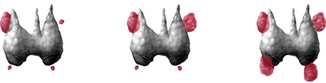
Update on
Hyperparathyroidism Management
Dr Nazmul Kabir Qureshi
MBBS MD FACE

Slide 2
Case A
Mrs X, 65 years of age,
Has hypertension, treated with ACE I.
Had complaints of constipation.
Her TFT was normal and serum total calcium level was 2.70 mmol/L (range 2.12–2.62).

Slide 3
Further work-up revealed:
Serum PTH 29.8 pmol/L (range 1.6–6.9)
Fractional urinary excretion of calcium 0.023 >0.02 (>0.01).
BMD scan of the lumbar spine: T score of –3.1.

Slide 4
Parathyroid sestamibi scan: single parathyroid adenoma.
Primary hyperparathyroidism complicated by osteoporosis.
Minimally Invasive Parathyroidectomy: Curative
Bone mineral density substantially improved 12 months after successful parathyroid surgery.

Slide 5
Case B
Mr X, 28 years of age, presents with polydipsia.
He takes no medication.
Biochemical screening reveals normoglycemia and
Hypercalcemia: 2.87 mmol/L (range 2.12–2.62)]

Slide 6
Serum PTH 5.9 pmol/L.
fractional urinary excretion of calcium 0.009, <0.01.
A bone mineral density scan shows a lumbar spine T score of 0.3.

Slide 7
Parathyroid sestamibi scan: not an adenoma.
F/H: His father and cousin had a history of mild hypercalcemia.
Familial hypocalciuric hypercalcemia (FHH) that does not require any treatment.
Genetic counselling should be arranged.
FHH mutation: confirmed.

Slide 8
Serum calcium and Parathyroid hormone(PTH):
Frequently requested in the work up of osteoporosis, renal and metabolic disorders.
Primary hyperparathyroidism and hypercalcemia of malignancy are the most common causes of hypercalcemia (>90%).
Marx SJ. Hyperparathyroid and Hypoparathyroid Disorders.
N Engl J Med 2000;343:1863–75.

Slide 9
Hyperparathyroidism
Excess PTH secretion from one or more of the four overactive parathyroid glands.
Either due to intrinsic abnormal change: Primary(PHPT) or Tertiary hyperparathyroidism.
OR from an abnormal calcium homoeostasis affecting production of PTH (Secondary hyperparathyroidism).
Marx SJ. Hyperparathyroid and Hypoparathyroid Disorders.
N Engl J Med 2000;343:1863–75.

Slide 10
PHPT
Hypercalcemia, Hypercalciuria
Elevated or inappropriately normal serum PTH
Hypophosphatemia.
Hyperparathyroidism (primary): diagnosis, assessment and initial management. NICE guideline 2019.

Slide 11
1 to 4 people/1,000 are known to have the condition.
It can develop at any age.
Women are twice as likely to develop primary hyperparathyroidism as men.
Women most often is diagnosed between the ages of 50 and 60 (post-menopausal).
Australian Family Physician Vol. 36, No. 12, December 2007

Slide 12
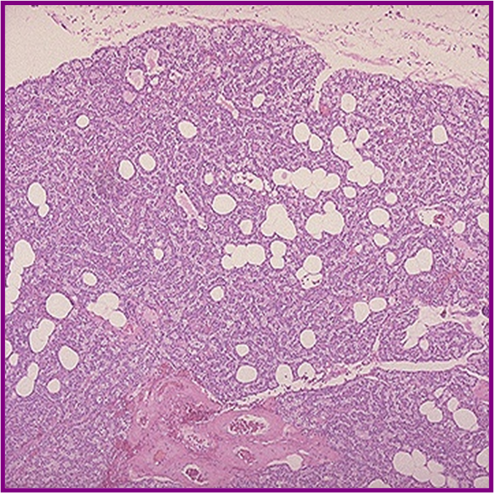
Four glands located behind the thyroid
Length 6 millimeters
Width 3 millimeters
Thickness 2 millimeters
Often accidentally removed
Normal function with at least 2 glands
Single adenoma: 85% of cases
Hyperplasia of multiple glands: 15% of cases.
Parathyroid carcinoma: Rare, <0.5%. (HRPT2,bcl-1, ki67)
Ectopic adenomatous parathyroid tissue, such as intrathoracic adenomas, have also been reported*.
Marx SJ. Hyperparathyroid and Hypoparathyroid Disorders.
N Engl J Med 2000;343:1863–75.
*Souza ER, Scrignoli JA, Bezerra FC, Ribeiro SL, Passos LF. Devastating skeletal
effects of delayed diagnosis of complicated primary hyperparathyroidism
because of ectopic adenoma. J Clin Rheumatol 2008;14(5):281-4.

Slide 13
Rare familial disorders:
MEN type 1: MEN1
MEN type 2A: RET genes
Familial hyperparathyroidism–jaw tumor syndrome
Familial isolated hyperparathyroidism.
Neonatal severe hyperparathyroidism
[Familial hypocalciuric hypercalcemia (FHH)]
Australian Family Physician Vol. 36, No. 12, December 2007

Slide 14
Australian Family Physician Vol. 36, No. 12, December 2007

Slide 15
FHPT-JT
Familial hyperparathyroidism–jaw tumour syndrome: HRPT2 gene,
AD,
Young adults
Single parathyroid adenomas
Bony lesions of the jaw, renal hamartomas, or cystic kidney disease.
Teh BT, Farnebo F, Kristoffersson U, Sundelin B, Cardinal J, Axelson R, et al. Autosomal dominant primary hyperparathyroidism and jaw tumor syndrome associated with renal hamartomas and cystic kidney disease: linkage to 1q21- q32 and loss of the wild type allele in renal hamartomas. J Clin Endocrinol Metab 1996;81(12):4204-11.

Slide 16
MEN type I: PHPT Almost universal feature 95%. (pituitary adenomas and pancreatic tumors)
MEN type IIA: 35% of patients PHPT. (medullary thyroid carcinoma, bilateral Pheochromocytoma)
Australian Family Physician Vol. 36, No. 12, December 2007

Slide 17
Lithium: Decreases the parathyroid gland’s sensitivity to calcium causing parathyroid hyperplasia with prolonged use> increases in serum levels of PTH and Ca.
Also unmask pre-existing parathyroid adenomas.
Lithium lowers urinary calcium excretion by decreasing the sensitivity of the calcium sensing receptors kidney to calcium.
11. Haden ST, Stoll AT, McCormick S, Scott J, Fuleihan G el-H. Alterations in parathyroid hormone dynamics in lithium-treated subjects. J Clin Endocrinol Metab 1997;82(9):2844-8.

Slide 18
Thiazide diuretics might unmask underlying PHPT, as they cause mild hypercalcemia by reducing urinary calcium excretion;
PHPT is likely if hypercalcemia persists after stopping the medication.
Radiation exposure to the head and neck region
Radioactive iodine therapy might also contribute to the development of PHPT.
[only small case series supporting this pathogenesis]
Beard CM, Heath H 3rd, O’Fallon WM, Anderson JA, Earle JD, Melton LJ 3rd. Therapeutic radiation and hyperparathyroidism. A case-control study in Rochester, Minn. Arch Intern Med. 1989;149(8):1887-90.
Schneider AB, Gierlowski TC, Shore-Freedman E, Stovall M, Ron E, Lubin J. Dose-response relationships for radiation-induced hyperparathyroidism. J Clin Endocrinol Metab 1995;80(1):254-7.
Wermers RA, Kearns AE, Jenkins GD, Melton LJ 3rd. Incidence and clinicalspectrum of thiazide-associated hypercalcemia. Am J Med 2007;120(10):911. e9-15. Epub 2007 Apr 16

Slide 19
FHH: AD, high penetrance, benign.
Inactivating mutation of the calcium-sensing receptor gene, which makes the receptor less sensitive to calcium in the parathyroid glands and the kidneys.
Parathyroid: Higher serum calcium level is required to reduce PTH secretion.
Kidney: renal calcium clearance is inappropriately low.
Family members should also be assessed.
Homozygote state causes life threatening neonatal hyperparathyroidism requiring total parathyroidectomy.
Eastell R, Arnold A, Brandi ML, Brown EM, D’Amour P, Hanley DA, et al. Diagnosis of asymptomatic primary hyperparathyroidism: proceedings of thethird international workshop. J Clin Endocrinol Metab 2009;94(2):340-50.

Slide 20
Secondary HPT
Secondary Causes of Elevated PTH Levels:
CKD: Creatinine clearance <60 ml/min
Malabsorption syndromes Celiac disease, inflammatory bowel disease, gastric bypass surgery.
Vitamin D Insufficiency/ deficiency
Hypercalciuria secondary to renal leak Renal hypercalciuria
Medications (calcium normal or low): Thiazide and loop diuretics, lithium
  Usually asymptomatic.
Diagnosis
  Elevated PTH in the setting of low or normal serum calcium
  If phosphorous is elevated, cause is renal
  If phosphorous is low, other causes: Vit D Def.
AAES Guidelines for Primary Hyperparathyroidism Management. JAMA Surgery October 2016 Volume 151, Number 10

Slide 21
Tertiary HPT
  Results from Long-standing secondary hyperparathyroidism (chronic hypocalcaemia)
  commonly CKD, also in other states, which stimulates the growth of an autonomous adenoma.
  Intractable hypercalcemia and/or an inability to control osteomalacia despite vitamin D therapy.

Slide 22
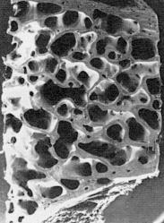

PHPT
Presentations:
Symptomatic & Hypercalcemia:
Asymptomatic; Hypercalcemia detected incidentally, or
End-organ damage.
[Normocalcemic hyperparathyroidism.]
Often may not correlate with degree of Hypercalcemia
Pallan S, Khan A. Primary hyperparathyroidism. Update on presentation, diagnosis, and management in primary care. Can Fam Physician 2011;57:184-9

Slide 23
Symptomatic hypercalcemia:
Long standing
Developing countries
Younger
Renal and skeletal complications: might be present at initial presentation.
Classic presentations:
Bones: Fractures…
Stones: Renal calculi…
Abdominal moans: Pancreatitis….
Psychic groans: Neuropsychiatric disturbances…
[*With increased availability of serum calcium testing, these classic symptoms are now uncommon.]
Pallan S, Khan A. Primary hyperparathyroidism. Update on presentation, diagnosis, and management in primary care. Can Fam Physician 2011;57:184-9
Mishra SK, Agarwal G, Kar DK, Gupta SK, Mithal A, Rastad J. Unique clinical characteristics of primary hyperparathyroidism in India. Br J Surg2001;88(5):708-14.

Slide 24
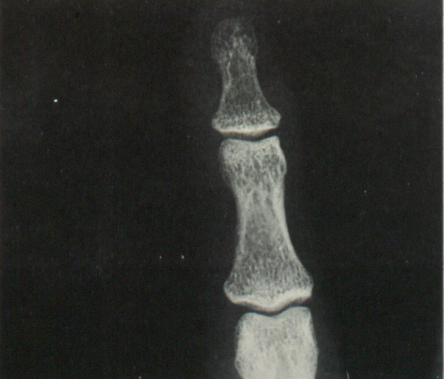
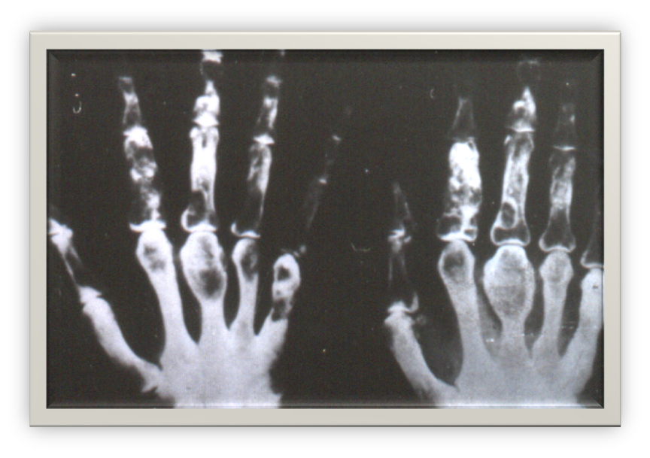
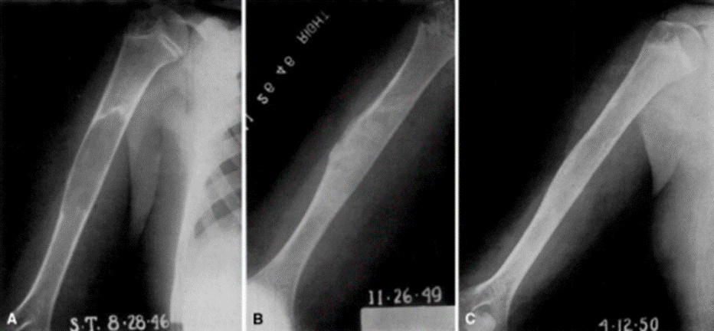
Spectrum of bone disease:
Low BMD most substantial at cortical sites
Osteoporosis, all sites, > peripheral cortical bones> Fragility fractures.
Radiographic changes: uncommon; subperiosteal resorption, abnormal skull vault, eroded lamina dura around teeth, bone cyst
Rarely, osteitis fibrosa cystica.
Pallan S, Khan A. Primary hyperparathyroidism. Update on presentation, diagnosis, and management in primary care. Can Fam Physician 2011;57:184-9

Slide 25
Renal manifestation:
Nephrolithiasis
Nephrocalcinosis
Polyuria
Renal insufficiency
Gastrointestinal symptoms:
Nausea, PUD, constipation, and pancreatitis.
Neuropsychiatric disturbances:
Lethargy, decreased cognitive and social function, psychosis, coma with severe hypercalcemia.
Pallan S, Khan A. Primary hyperparathyroidism. Update on presentation, diagnosis, and management in primary care. Can Fam Physician 2011;57:184-9
Carroll MF, Schade DS. A practical approach to hypercalcemia. Am Fam Physician 2003;67(9):1959-66.

Slide 26
Others
Joints:
Chondrocalcinosis
Pseudogout
Cardiovascular:
Left ventricular hypertrophy, endothelial dysfunction, conduction abnormalities shortened QT intervals
Non-specific symptoms
Fatigue
Mild depression
Cognitive impairment
Helliwell M. Rheumatic symptoms in primary hyperparathyroidism. Postgrad
Med J 1983;59(690):236-40.
Silverberg SJ, Lewiecki EM, Mosekilde L, Peacock M, Rubin MR. Presentation of asymptomatic primary hyperparathyroidism: proceedings of the third international workshop. J Clin Endocrinol Metab 2009;94(2):351-65.

Slide 27
Hypercalcemic crisis: rare
Precipitated by an intercurrent illness or volume depletion
Usually presents with very high serum calcium and PTH levels.
Pallan S, Khan A. Primary hyperparathyroidism. Update on presentation, diagnosis, and management in primary care. Can Fam Physician 2011;57:184-9

Slide 28
Normocalcemic Hyperparathyroidism: Less common
Might initially present for evaluation of low BMD, osteoporosis, or fragility fractures.
Normal serum calcium and persistently elevated PTH in the absence of vitamin D insufficiency or chronic kidney disease.
Lowe H, McMahon DJ, Rubin MR, Bilezikian JP, Silverberg SJ. Normocalcemic primary hyperparathyroidism: further characterizatioof a new clinical phenotype. J Clin Endocrinol Metab 2007;92(8):3001-5. Epub 2007

Slide 29
Natural history: is not well known.
Some patients progress to hypercalcemic hyperparathyroidism.
Before confirming this diagnosis, it is essential to exclude vitamin D deficiency and CKD, as these conditions can present with increased PTH levels and normal calcium.
Lundgren E, Hagström EG, Lundin J, Winnerbäck K, Roos J, Ljunghall S, et al. Primary hyperparathyroidism revisited in menopausal women with serum calcium in the upper normal range at population-based screening 8 years ago. World J Surg 2002;26(8):931-6

Slide 30
Now a days,
Approximately >80% of patients with PHPT are asymptomatic; detected incidentally on routine biochemical assays.
Silverberg SJ, Bilzekian JP. Primary hyperparathyroidism:
still evolving? J Bone Mine Metab 1997;12:856–62.

Slide 31
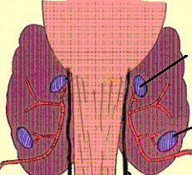
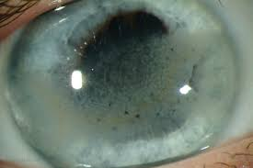
Physical findings
No specific; physical signs of complications.
Exclude neck masses: Parathyroid adenomas or carcinomas are rarely palpable;
Band keratopathy, which is the deposition of calcium phosphate in the exposed regions of the cornea (detected by a slit-lamp examination) is exceedingly rare.
Carroll MF, Schade DS. A practical approach to hypercalcemia. Am FamPhysician 2003;67(9):1959-66.

Slide 32
Diagnosis PHPT
Albumin-adjusted serum calcium ≥2.6 mmol/L
Elevated or inappropriately ‘normal’ serum PTH level.
PTH above midpoint (>3) of the reference range: primary hyperparathyroidism is suspected.
Phosphate levels (decreased or low-normal)
Fractional urinary excretion of calcium >0.02.
[The fractional excretion of calcium is calculated as: urine calcium x serum creatinine) ÷ (serum calcium x urine creatinine] Fasting state
Hyperparathyroidism (primary): diagnosis, assessment and initial management. NICE guideline 2019.

Slide 33
Albumin-adjusted Serum Ca
Following features, might indicate primary hyperparathyroidism:
  symptoms of hypercalcemia, such as thirst, frequent or excessive urination
  constipation
  osteoporosis or a previous fragility fracture
  a renal stone
  an incidental finding of elevated albumin-adjusted serum calcium (2.6 mmol/litre or above).
Hyperparathyroidism (primary): diagnosis, assessment and initial management. NICE guideline 2019.

Slide 34
Do not measure ionised calcium when testing for primary hyperparathyroidism.
Repeat the albumin-adjusted serum calcium measurement at least once if the first measurement is either:
2.6mmol/litre or above OR
2.5 mmol/litre or above and features of primary hyperparathyroidism are present.
Hyperparathyroidism (primary): diagnosis, assessment and initial management. NICE guideline 2019.

Slide 35
PTH
Measure PTH in People whose albumin-adjusted serum calcium level is either:
2.6mmol/litre or above on at least 2 separate occasions or
2.5 mmol/litre or above on at least 2 separate occasions and primary hyperparathyroidism is suspected.
10-60pg/ml or 1-6 pmol/L, Fasting/Random sample and a concurrent albumin-adjusted serum calcium level.
Hyperparathyroidism (primary): diagnosis, assessment and initial management. NICE guideline 2019.

Slide 36
No further investigations if:
PTH is below the midpoint of the reference range and
concurrent albumin-adjusted serum calcium level is below 2.6 mmol/litre.
Hyperparathyroidism (primary): diagnosis, assessment and initial management. NICE guideline 2019.

Slide 37
Others
25(OH)D, PO4
End organ damages
24 h U ca ( +/- Urine creatinine)
Renal USG (calculi, nephrocalcinosis)
Skeletal radiograph ( thoracolumbar spine, hands, knees)
BMD: lumbar spine, distal radius and hip
Bone turn over markers
Hyperparathyroidism (primary): diagnosis, assessment and initial management. NICE guideline 2019.

Slide 39
Bone turnover markers:
bone specific alkaline phosphate; mildly elevated.
Genetic testing
  mutations in the MENIN and RET genes
  Mutations in the calcium-sensing receptor gene
24-hour urinary calcium excretion in the family members of the patient is helpful in confirming the presence of a familial parathyroid condition.
Hyperparathyroidism (primary): diagnosis, assessment and initial management. NICE guideline 2019.

Slide 40
Excluding other causes of hypercalcemia:
Bone metastasis, renal disease, calcium intake, vitamin D intoxication, immobilization, GI disorders.
Malignancy, sarcoidosis and other granulomatous disease, myeloma, thyroid disease, adrenal insufficiency.
Review of medications including thiazide diuretics and lithium.
Hyperparathyroidism (primary): diagnosis, assessment and initial management. NICE guideline 2019.

Slide 41
Localizing Parathyroid Gland(s)
Part of pre-operative assessment.
Not indicated for initial assessment.
USG
99m Tc-sestamibi scan
Separate technique is imperative: if minimally invasive procedure.
[CT, MRI]
Hyperparathyroidism (primary): diagnosis, assessment and initial management. NICE guideline 2019.

Slide 42
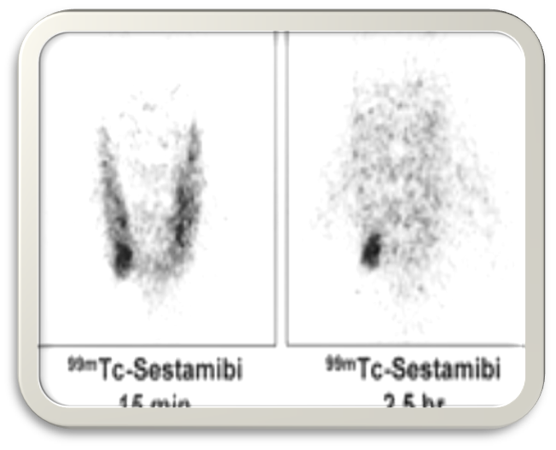
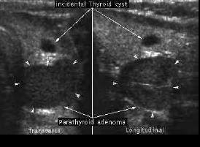
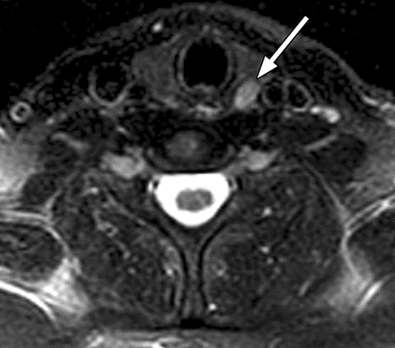
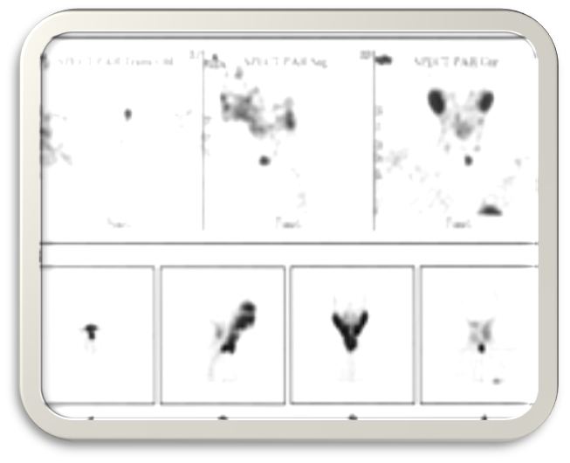

Slide 43
Do not offer more preoperative imaging
  if the first-modality (usually ultrasound) and second-modality scans (usually a sestamibi scan) do not identify an adenoma or are discordant: BE is optimal by experienced surgeon.
Hyperparathyroidism (primary): diagnosis, assessment and initial management. NICE guideline 2019.

Slide 44
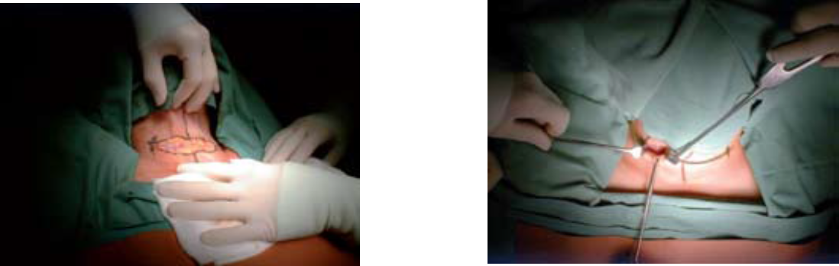
Parathyroidectomy
Operative management is more effective, cost-effective than long-term observation or pharmacologic Therapy.
Preoperative parathyroid FNA biopsy is not recommended […..except if PCA is suspected].
AAES Guidelines for Primary Hyperparathyroidism Management. JAMA Surgery October 2016 Volume 151, Number 10

Slide 45
Indication
2016
Symptomatic pHPT
Serum calcium level is greater than 1mg/dL above normal, regardless of whether objective symptoms
Evidence of renal involvement, including silent nephrolithiasis on renal imaging,
Nephrocalcinosis
Hypercalciuria (24-hoururine calcium level >400mg/dL) with increased stone risk, or impaired renal function (glomerular filtration rate <60 mL/min)
AAES Guidelines for Primary Hyperparathyroidism Management. JAMA Surgery October 2016 Volume 151, Number 10

Slide 46
Patients with pHPT and osteoporosis, fragility fracture, or evidence of vertebral compression fracture on spine imaging.
pHPT is diagnosed at 50 years or younger regardless of objective or subjective features
Patient present with hypercalcemic crisis should be medically managed, followed by parathyroidectomy.
AAES Guidelines for Primary Hyperparathyroidism Management. JAMA Surgery October 2016 Volume 151, Number 10

Slide 47
PCA
Unable or unwilling to comply with observation protocols
Recommended for patients with neurocognitive and/or neuropsychiatric symptoms that are attributable to HPT
AAES Guidelines for Primary Hyperparathyroidism Management. JAMA Surgery October 2016 Volume 151, Number 10

Slide 48
May be offered: to surgical candidates with cardiovascular disease who might benefit from mitigation of potential cardiovascular sequelae other than Hypertension
May be considered: nontraditional symptoms of muscle weakness, gastroesophageal reflux and fibromyalgia, abnormal sleep patterns.
AAES Guidelines for Primary Hyperparathyroidism Management. JAMA Surgery October 2016 Volume 151, Number 10

Slide 49
NICE 2019: Referral for surgery
Symptoms of hypercalcaemia [such as thirst, frequent or excessive urination, constipation] or
End-organ disease (renal stones, fragility fractures or osteoporosis) or
an albumin-adjusted serum calcium level of 2.85 mmol/litre or above.
Consider referral to a surgeon with expertise in parathyroid surgery for
  people with a confirmed diagnosis of primary hyperparathyroidism
  even if they do not have the features.
Hyperparathyroidism (primary): diagnosis, assessment and initial management. NICE guideline 2019.

Slide 50
Offer: either 4-gland exploration or focused parathyroidectomy: preoperative imaging single adenoma.
Offer: 4-gland exploration who have had preoperative imaging does not identify a single adenoma.
Consider: 4-gland exploration whose first-modality and second-modality scans are discordant.
Hyperparathyroidism (primary): diagnosis, assessment and initial management. NICE guideline 2019.

Slide 51
Bilateral Exploration (BE)
Time tested, standard of definitive treatment of pHPT
lithium-induced pHPT, the surgical approach may be BE or MIP guided by imaging and IPM.
MEN 1–associated pHPT, Total/ subtotal (AAES) parathyroidectomy, autotransplantation
of parathyroid tissue to the forearm.
MEN 2A–associated pHPT, resection of only visibly enlarged glands is recommended.
AAES Guidelines for Primary Hyperparathyroidism Management. JAMA Surgery October 2016 Volume 151, Number 10

Slide 52
Minimally Invasive Parathyroidectomy (MIP)
Single parathyroid adenoma.
Not routinely recommended in known or suspected high risk of MGD.
When focused parathyroidectomy is planned, IPM is suggested to avoid higher operative failure rates.
During MIP, the discovery of MGD, or the failure to achieve an appropriate IPM decrease should prompt conversion to BE
AAES Guidelines for Primary Hyperparathyroidism Management. JAMA Surgery October 2016 Volume 151, Number 10

Slide 53
Extent of Parathyroidectomy
Number of Glands Involved Procedure
  All 4 Removal of 3 glands and all but 35- 50 mg of the fourth gland
Two or 3 Removal of all but half of a normal gland; suture tagging of remaining half.
One Removal of involved gland;

Slide 54
Auto-transplantation: Treat each parathyroid gland as carefully as if it were the last.
  maximal amount of normal parathyroid tissue possible.
AAES Guidelines for Primary Hyperparathyroidism Management. JAMA Surgery October 2016 Volume 151, Number 10

Slide 55
Parathyroid carcinoma:
  With intraoperative suspicion, complete resection avoiding capsular disruption.
  May require en bloc resection of adherent tissues
  Adjuvant external beam radiotherapy should not be routinely performed after surgical resection of PCA and is reserved as a palliative option
Thyroid Evaluation:
  should have preoperative thyroid evaluation because of the high rate of concomitant disease
Concomitant pHPT and thyroid disease that requires resection
  thyroid resection at the time of parathyroidectomy.
AAES Guidelines for Primary Hyperparathyroidism Management. JAMA Surgery October 2016 Volume 151, Number 10

Slide 56
After parathyroidectomy, monitoring
Compressive hematoma prompt emergency decompression
Vocal cord paresis: transient
RLN transection is recognized during parathyroidectomy, a reinnervation procedure should be attempted
Hypocalcemia:
Transient hypoparathyroidism: treated with calcium and, if necessary, calcitriol supplements, which should be weaned as tolerated.
AAES Guidelines for Primary Hyperparathyroidism Management. JAMA Surgery October 2016 Volume 151, Number 10

Slide 57
Prolonged hypoparathyroidism: >6/12 months, considered for rPTH therapy (1-84, Natpara, 50mcg S/C, AE: Osteosarcoma) FDA-approved.
Monitoring: to avoid complications of hypercalcemia,
  nephrolithiasis, nephrocalcinosis, renal insufficiency,
  soft tissue calcification, cataracts,
  Depression, basal ganglia calcification
  Severe Hypocalcemia: due to hungry bone disease, with pre-existing bone disease; pre-treatment, oral/IV ca.

Slide 58
Serum calcium and PTH before discharge: After surgery for primary hyperparathyroidism to provide baseline information for later follow-up.
If albumin-adjusted serum calcium is within the reference range 3 to 6 months after surgery for primary hyperparathyroidism, regard the surgery as successful.
Monitor albumin-adjusted serum calcium once a year.
Hyperparathyroidism (primary): diagnosis, assessment and initial management. NICE guideline 2019.

Slide 59
AAES Guidelines for Primary Hyperparathyroidism Management. JAMA Surgery October 2016 Volume 151, Number 10

Slide 60
MEN type IIA: exclude phaeochromocytoma before parathyroid surgery in order to prevent a possible life threatening phaeochromocytoma crisis precipitated by anesthesia.
Australian Family Physician Vol. 36, No. 12, December 2007

Slide 61
Medical Management
Designed to target skeletal protection or lower serum calcium.
Mild disease, no organ damage
Those with contraindications to, or those who do not wish to have, surgery.
  Bisphosphonate class, alendronate in particular has been shown to decrease bone turnover and increase BMD in PHPT.
  Hormone replacement therapy (HRT) also improved BMD in postmenopausal women with mild PHPT.
Pallan S, Khan A. Primary hyperparathyroidism. Update on presentation, diagnosis, and management in primary care. Can Fam Physician 2011;57:184-9

Slide 62
Bisphosphonates, HRT, and raloxifene do not lower serum calcium or PTH levels.
Cinacalcet 30 mg tds (Mimpara): A calcimimetic agent, reduces both serum calcium and PTH levels, not urinary Ca. Does not have any effects on bone turnover or BMD.
Pallan S, Khan A. Primary hyperparathyroidism. Update on presentation, diagnosis, and management in primary care. Can Fam Physician 2011;57:184-9

Slide 63
Cinacalcet is not routinely used for management of asymptomatic PHPT. (2nd /intractable case of primary HPT/THPT/Ca-Para)
Consider cinacalcet in PHPT:
  if surgery has been unsuccessful,
  is unsuitable
  has been declined
  if their albumin adjusted serum calcium level is either: 2.85mmol/litre or above with symptoms
  3.0 mmol/litre or above with or without symptoms of hypercalcaemia.
Hyperparathyroidism (primary): diagnosis, assessment and initial management. NICE guideline 2019.

Slide 64
Physical activity (to decrease bone resorption) and
Adequate hydration (to reduce the risk of developing serious hypercalcemia or nephrolithiasis).
Moderate calcium and vitamin D intake should be maintained.
Vitamin D should be repleted carefully, to reduce the risk of worsening hypercalcemia.
Avoid factors that exacerbate hypercalcemia:
  Lithium
  Hydrochlorothiazide therapy
  Immobilization
  Volume depletion.
Pallan S, Khan A. Primary hyperparathyroidism. Update on presentation, diagnosis, and management in primary care. Can Fam Physician 2011;57:184-9

Slide 65
Observation & surveillance:
Patients with asymptomatic PHPT, mild disease, no organ damage:
Serum calcium: Annually
Serum creatinine: Annually
Creatinine clearance: Annually
Bone mineral density Every 1-2-3 y (3 sites)
Abdominal x-ray with or without ultrasound: Every 1-2-3 y
[24-h urinary calcium, PTH, BP]
Any significant deterioration> Surgery
Bilezikian JP, Khan AA, Potts JT Jr. Guidelines for the management of asymptomatic primary hyperparathyroidism: summary statement from the third international workshop. J Clin Endocrinol Metab 2009;94(2):335-9.

Slide 66
Bilezikian et al Primary Hyperparathyroidism: Management Guidelines J Clin Endocrinol Metab, October 2014, 99(10):3561–3569

Slide 67
Bilezikian et al Primary Hyperparathyroidism: Management Guidelines J Clin Endocrinol Metab, October 2014, 99(10):3561–3569

Slide 68
Pregnancy
Before Pregnancy: Offer parathyroid surgery to women who have primary hyperparathyroidism and are considering pregnancy.
During: MDT in a specialist centre;The MDT should include:
an obstetrician
a physician with expertise in primary hyperparathyroidism a surgeon
a midwife
an anaesthetist.
Do not offer cinacalcet, bisphosphonate
©
Hyperparathyroidism (primary): diagnosis, assessment and initial management. NICE guideline 2019.

Slide 69
Acute severe (> 15 mg/dL) hypercalcemia
.
Hospitalization, Calcium restriction
Hydration and diuretics- 4-6 L of isotonic saline IV+ furosemide 20-100 mg every 1-2 hours/ Furosemide ( 40-160 mg/d orally) (when normovolumeia)
Pamidronate disodium. The initial dose is 60-90 mg by intravenous infusion over 4-24 hours.
Glucocorticoids: Pred 40 mg /day: counteracting the effects of vitamin D
Salmon calcitonin: 400 IU IM q 6hr

Slide 70
Tertiary HPT
Secondary HPT
  Surgical Referral:
  severe bone disease and pain
  intractable pruritus
  extensive soft tissue calcification
  calciphylaxis
  Treatment
  Vit D replacement
  Phosphorus binders
  Calcimimetic agents

Slide 71
Summary: HPT
Excess PTH secretion from one or more of the four overactive parathyroid glands.
Post-menopausal
Single adenoma: 85% of cases, Rare familial disorders, need to exclude FHH, benign disorder, drug effects.
>80%, asymptomatic, classical features less common, may present with target organ damage.
Alb-ad serum calcium ≥2.6 mmol/L
Elevated or inappropriately ‘normal (>3)’ serum PTH level.
Fractional urinary excretion of calcium >0.02.
Exclude Vit D Def and CKD & Other factors (2nd & >S. Ca)
Localizing is indicated during pre-operative assessment.

Slide 72
Parathyroidectomy (BE / MIP):
Symptoms of hypercalcaemia,
End-organ disease (renal stones, fragility fractures or osteoporosis), albumin-adjusted Ca 2.85 mmol/litre or above,
<50 age,
24 U Ca>400mg/dl…...
Alb-ad serum calcium is within the reference range 3 to 6 months after surgery,
regard the surgery as successful.

Slide 73
Medical management: non-operable cases, Cinacalcet & Bisphos should not be used during pregnanacy
Observation protocol: Serum calcium,
Serum creatinine, Creatinine clearance: Annually,
Bone mineral density Every 1-2-3 y (3 sites),
Abdominal x-ray with or without ultrasound: Every 1-2-3 y
[24-h urinary calcium, PTH, BP],
Any significant deterioration> Surgery

