Slide 1
T2DM management during COVID-19 & Clinical Place of SGLT 2 inhibitors
Management priorities for patients with T2D during the COVID-19 outbreak & Guideline & evidence based recommendations of SGLT2 Inhibitors
Confidential. For internal use only. Do not distribute.

Slide 2
People with diabetes and related comorbidities
are
at
a
higher
risk
of
complications
from
COVID-19
High-risk populations include those:
• Aged 65 years and older
• Living in a nursing home or long-term care facility
• With chronic lung disease or moderate–severe asthma
• With serious cardiovascular disease
• Who are immunocompromised*
• With severe obesity or underlying conditions,† including
diabetes, kidney failure or liver disease
• Who are pregnant‡
*Includes those on cancer treatment, who smoke, have had a bone marrow or organ transplant, immune deficiencies, poorly controlled human immunodeficiency
virus/acquired immune deficiency syndrome, prolonged use of corticosteroids, and other immune weakening medications; †Particularly if not well controlled;
‡Pregnant women should be monitored as they are known to be at risk with severe viral illness, although to date evidence on COVID-19 has not shown increased risk
Centers for Disease Control and Prevention. 2020. https://www.cdc.gov/coronavirus/2019-ncov/specific-groups/people-at-higher-risk.html (accessed Apr 2020)
Confidential. For internal use only. Do not distribute.
1

Slide 3
COVID-19-related mortality rates are higher in patients
with diabetes compared with the general population
A report of 44,672 cases of COVID-19
published
by
the
Chinese
Centre
for
Disease
Control
and
Prevention
8
7.3%
2.3%
6
Mortality (%)
4
2
0
Overall
population
Patients
with diabetes
Wu Z et al. J Am Med Assoc 2020; doi.org/10.1001/jama.2020.2648
Confidential. For internal use only. Do not distribute.
2

Slide 4
Providing optimal care for patients with
diabetes
during
the
COVID-19
outbreak
Optimal glycaemic control
Now is the time to better educate patients on
self-management
of their diabetes
and comorbidities
CV risk factor and lifestyle management
Adherence to medication
Reassurance and support
•
General guidance on preventative measures during the COVID-19 outbreak
should also be followed
Confidential. For internal use only. Do not distribute.
3

Slide 5
Good glycaemic control may help
reduce
infection¹
the
risk
and
severity
of
COVID-19
Optimal glycaemic control
Patients should be advised to:
❑ Monitor their blood glucose levels
more frequently^{1,2}
❑ Monitor for signs of hyperglycaemia²
CV risk factor and
lifestyle management
Adherence
to medication
Reassurance and support
1. Gupta R et al. Diabetes Metab Syndr 2020;14:211; 2. Diabetes UK. Coronavirus and diabetes. https://www.diabetes.org.uk/about_us/news/coronavirus
(accessed Apr 2020)
Confidential. For internal use only. Do not distribute.
4

Slide 6
CV risk factor and
lifestyle management are important factors
that
should
not
be
forgotten
during
the
COVID-19
outbreak
Optimal glycaemic control
❑ Special efforts should be made to stabilise patients with co-existing heart and/or kidney disease
❑ Nutritional deficiencies should be treated*
❑ Exercise should be encouraged, because it is shown to improve immunity
❑ Vaccinations should be taken for influenza
and pneumonia†
CV risk factor and
lifestyle management
Adherence
to medication
Reassurance and support
*Including protein and vitamin/mineral deficiencies; †Vaccinations for pneumonia may decrease the chances of secondary bacterial pneumonia after
respiratory viral infection; however, data on the present viral epidemic are not available
Gupta R et al. Diabetes Metab Syndr 2020;14:211
Confidential. For internal use only. Do not distribute.
5

Slide 7
There is currently no reason for patients taking NSAIDs
to
interrupt
their
treatment
during the COVID-19 outbreak¹
Optimal glycaemic control
CV risk factor and
lifestyle management
NSAIDs
❑ Advise patients to keep taking their NSAIDs as per approved product information
▪ This is particularly important for those taking
NSAIDs for chronic diseases¹
❑ Consider all available treatment options when
treating for fever or pain¹
▪ Most EU national treatment guidelines recommend
paracetamol as a first-line treatment option¹
▪ Inform patients that paracetamol, especially if taken repeatedly at high dose, may cause a false rise in glucose sensor values*²
Adherence
to medication
Reassurance and support
*See the reference for further information
NSAID, non-steroidal anti-inflammatory drug
1. European Medicines Agency. 2020. https://www.ema.europa.eu/en/news/ema-gives-advice-use-non-steroidal-anti-inflammatories-covid-19 (accessed Apr 2020);
2. EASD e-learning. Tips: Diabetes and COVID-19; Glucose sensors and paracetamol. https://easd-elearning.org/covid-19/ (accessed Apr 2020)
Confidential. For internal use only. Do not distribute.
6

Slide 8
There is currently no confirmed link between ACEi/ARB
treatment
and
the
risk
of
COVID-19 and its complications¹
Optimal glycaemic control
CV risk factor and
lifestyle management
Antihypertensive
medications
❑ Advise patients not to stop or change medications
without consulting their HCP¹
▪ Blood pressure control is essential for managing diabetes and is recommended for protection from kidney- and heart-related complications, even in the absence of
high blood pressure¹
▪ Hypertension was the most prevalent
comorbidity reported in patients with
COVID-19 infection*²
Adherence
to medication
Reassurance and support
*Of 1590 patients in China with COVID-19, with or without diabetes
ACEi, angiotensin-converting enzyme inhibitor; ARB, angiotensin receptor blocker
1. Diabetes Canada. Facts about COVID-19 and diabetes. https://www.diabetes.ca/en-CA/resources/tools---resources/faq-about-covid-19-and-diabetes
(accessed Apr 2020); 2. Guan W et al. Eur Respir J 2020; doi.org/10.1183/13993003.00547-2020
Confidential. For internal use only. Do not distribute.
7

Slide 9
Patients may be worried about their condition
during the
reassurance
COVID-19
outbreak;
it
is
important
to
provide
Optimal glycaemic control
CV risk factor and
lifestyle management
Adherence
to medication
❑ Recommend that patients speak with friends, family
or dedicated helplines to relieve mental pressures¹
❑ Direct patients to verified resources to avoid misinformation
❑ Ensure your patients are aware and prepared in case
they contract the COVID-19 infection:
▪ Sick-day guidance¹
▪ Plentiful supply of medication²
Reassurance and support
1. Diabetes UK. Coronavirus and diabetes. https://www.diabetes.org.uk/about_us/news/coronavirus (accessed Apr 2020);
2. Diabetes Canada. Facts about COVID-19 and diabetes. https://www.diabetes.ca/en-CA/resources/tools---resources/faq-about-covid-19-and-diabetes
(accessed Apr 2020)
Confidential. For internal use only. Do not distribute.
8

Slide 10
What should be done if a patient
with
diabetes
in
your
care
has
COVID-19?
• Notify the appropriate health authority in case a person with diabetes
develops fever, cough, runny nose or dyspnoea
• Ensure the affected person is isolated for 14 days or until the symptoms
resolve (whichever is longer)
• Follow general sick-day guidance for patients with diabetes
– The majority of patients have a mild disease and can be managed at home
– Symptomatic treatment with paracetamol, steam insulation, etc. can be given
Gupta R et al. Diabetes Metab Syndr 2020;14:211
Confidential. For internal use only. Do not distribute.
9

Slide 11
In periods of acute illness, all patients should follow
sick-day
rules
to
minimise
risk of complications
(1)
MONITOR
Hydration status: drink plenty of water and try to eat
as
normal
Blood glucose
• If monitored Check for symptoms of routinely, check high blood glucose: more frequently • Thirst/dry mouth
(every 4 hours) • Passing large amounts of urine
and keep records • Tiredness
• Weight loss (check every day)
SEEK ADVICE
(from an HCP)
MEDICATIONS
Ketone bodies: if monitoring advised and kit provided
Temperature: every morning and evening
International Diabetes Foundation. Sick day management. https://www.idf.org/component/attachments/?task=download&id=2155:IDFE-Sick-day-
management (accessed Apr 2020)
Confidential. For internal use only. Do not distribute.
10

Slide 12
In periods of acute illness, all patients should follow
sick-day
rules
to
minimise
risk of complications
(2)
MONITOR
If unsure what to do¹
If vomiting repeatedly (unable to hold down food/drink
for
>6 hours)¹
If blood glucose is very high for >24 hours¹
SEEK ADVICE
If showing symptoms/signs of DKA²
(from
an
HCP)
MEDICATIONS
DKA, diabetic ketoacidosis; SGLT2, sodium-glucose co-transporter-2; T1D, type 1 diabetes; T2D, type 2 diabetes
1. International Diabetes Foundation. Sick day management. https://www.idf.org/component/attachments/?task=download&id=2155:IDFE-Sick-day- management (accessed Apr 2020); 2. Down S. Diabetes & Primary Care 2018;20:15; 3. Wilding J et al. Diabetes Ther 2018;9:1757
Confidential. For internal use only. Do not distribute.
11

Slide 13
In periods of acute illness, all patients should follow
sick-day
rules
to
minimise
risk
of
complications
(3)
MONITOR
Take medications as normal unless advised otherwise by a HCP¹
These medications should be temporarily stopped during acute illnesses that can cause dehydration or acute decline
in renal function:^{2,3}
S
Sulphonylureas
A
ACE inhibitors
SEEK ADVICE
(from an HCP)
D
Diuretics
M
Metformin
A
ARBs
N
NSAIDs
MEDICATIONS
S
SGLT2 inhibitors
Once the person is feeling better and able to eat and drink for 24–48 hours, these medications should be restarted²
• Insulin is the preferred agent for control of hyperglycaemia in hospitalised sick patients⁴
ACE, angiotensin-converting enzyme; ARB, angiotensin receptor blocker; NSAID, non-steroidal anti-inflammatory drug; SGLT2, sodium-glucose co-transporter-2
1. International Diabetes Foundation. Sick day management. https://www.idf.org/component/attachments/?task=download&id=2155:IDFE-Sick-day-management
(accessed Apr 2020); 2. Down S. Diabetes & Primary Care 2018;20:15; 3. Canadian Diabetes Association. Can J Diabetes 2018:42;S316; 4. Gupta R et al. Diabetes Metab Syndr
2020;14:211
Confidential. For internal use only. Do not distribute.
12

Slide 14
Clinical Place of
SGLT-2 inhibitors
Confidential. For internal use only. Do not distribute.
13

Slide 15
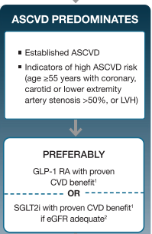
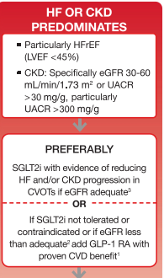
Standards of Medical Care - 2020
Metformin
SGLT2 inhibitors as 2nd Line Therapy for CV & Renal Benefits

Slide 16
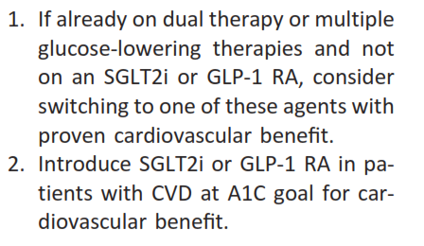
Standards of Medical Care - 2020

Slide 17
ESC 2019 Diabetes Recommendation
In Drug Naïve patients
SGLT2i recommended as monotherapy
Who are on Metformin
SGLT2i recommended to be added

Slide 18
SGLT2-i & GLP1-RA Have Been Shown to Reduce the Risk of CV Events

Slide 19
EMPA-REG OUTCOME®: a randomised, double-blind, placebo-controlled CV outcomes trial
OBJECTIVE
To examine the long-term effects of empagliflozin versus placebo, on top of standard of care, on CV morbidity and mortality in patients with T2D and established CV disease
7020 patients
42 countries
Notes:
Notes
Concerns that specific diabetes drugs could potentially be associated with adverse CV outcomes resulted in a regulatory mandate to assess the CV safety of T2D drugs in dedicated CVOTs^{1,2}
EMPA-REG OUTCOME® is a dedicated CVOT for empagliflozin in patients with T2D and established CV disease³
High risk for CV disease was defined as the presence of at least one of the following:
Myocardial infarction >2 months prior to informed consent
Evidence of single- or multi-vessel coronary disease
Unstable angina >2 months prior to informed consent
Stroke >2 months prior to informed consent
Occlusive peripheral artery disease
Effects of empagliflozin were measured for a median of 3.1 years of observation time
Median duration of treatment was 2.6 years
Abbreviations
CV, cardiovascular; CVOT cardiovascular outcome trial; T2D, type 2 diabetes
References
Udell JA et al. Lancet Diabetes Endocrinol 2015;3:356
Department of Health and Human Services, Food and Drug Administration. Guidance for industry: diabetes mellitus — evaluating cardiovascular risk in new antidiabetic therapies to treat type 2 diabetes. www.fda.gov/downloads/drugs/guidancecomplianceregulatory information/guidances/ucm071627.pdf (accessed September 2018)
Zinman B et al. N Engl J Med 2015;373:2117

Slide 20
Clinical Outcome | Relative Risk Reduction
3-point MACE | 14%
CV Mortality | 38%
Hospitalizations for Heart Failure | 35%
Hospitalizations for HF or CV Mortality | 34%
Incident or Worsening Nephropathy | 39%
≥40% sustained Decline in eGFR | 45%
All-cause Mortality | 32%
ON TOP OF STANDARD OF
CARE (7020 pts randomized)
>48% insulin
>80% ACE-i/ARB
>76% Statins
≈89% Anti-platelet agents
Confidential. For internal use only. Do not distribute.
12

Slide 21
In patients of T2DM with CAD
Confidential. For internal use only. Do not distribute.
15

Slide 22
EMPA-HEART SUMMARY
In diabetic patient with hypertension and CVD leads to increase muscle size of left ventricle of heart that result in heart failure and few other complications.
Studies showed that this increased muscle mass (LVMi) can also increase CV event and death, Heart failure, re-infarction, stroke and systolic dysfunction.
EMPA HEART Trial :
This trial was enrolled to find out in which extent Jardiance reduces left ventricular mass size in 6 months:
Empagliflozin Reduced LVMi in T2DM with CAD upto 3.35gm/m2 (based on Cardiac MRI and Biomarkers) and thereby improves left ventricular function.
And the mechanisms are; reduction of preload and afterload, diuretic effect and improvement of vascular function.
LVMi – left ventricular mass index
CAD – coronary artery disease
Confidential. For internal use only. Do not distribute.
16

Slide 23
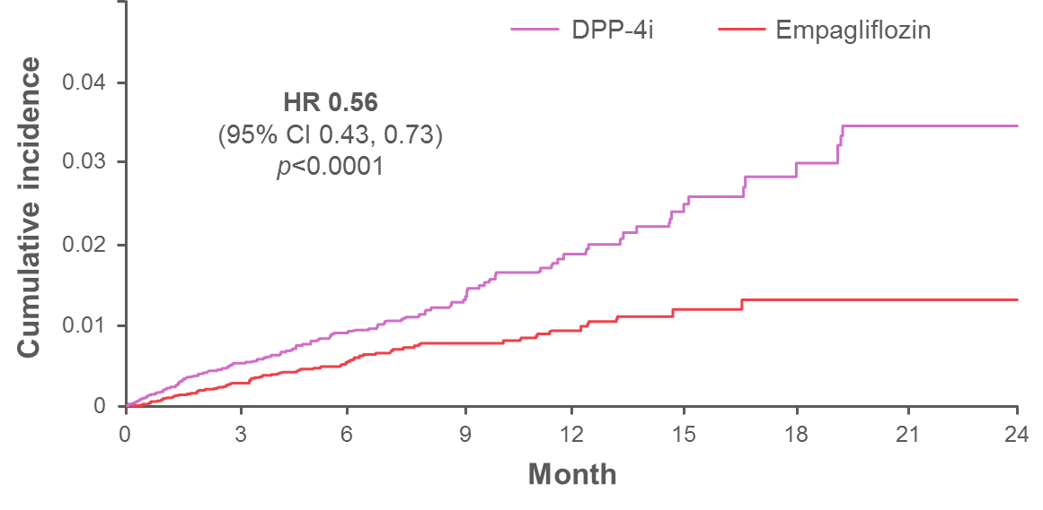
EMPAGLIFLOZIN vs DPP4i according to Real World Evidence
44%
REDUCTION
in HF and 49% compared to Sitagliptin
Confidential. For internal use only. Do not distribute.
17

Slide 24
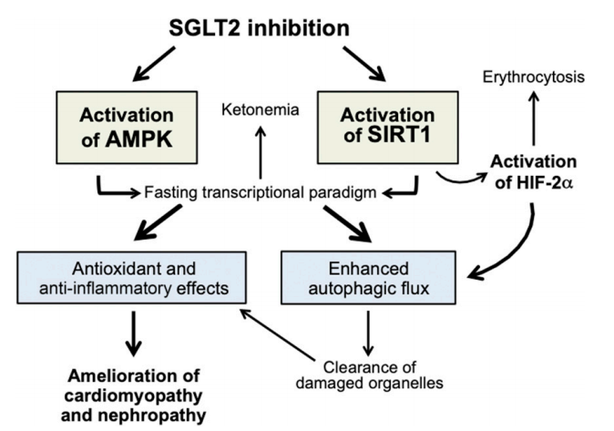
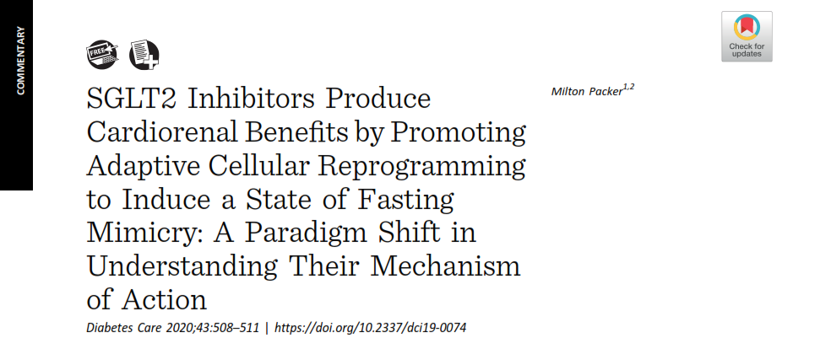
Mechanism of Cardio-renal protection
Diabetes Care 2020;43:508–511https://doi.org/10.2337/dci19-0074
18
Confidential. For internal use only. Do not distribute.

Slide 25
Key considerations for T2DM management in COVID-19 Outbreak
For prevention, and optimal care
For treating patients
diabetes and COVID-19 infection,
of
patients
with
diabetes,
consider:
with
follow
sick-day
guidance:
Optimal
glycaemic control
MONITOR
CV risk factor and lifestyle management
SEEK ADVICE
Adherence
to medication
MEDICATIONS
Reassurance and support
Confidential. For internal use only. Do not distribute.
19

