Slide 1
Non Comparable Biologics Vs. Originator Insulin- Risk and controversies
Dr. Nazmul Kabir Qureshi
Consultant, Uttara NHN

Slide 2
Meeting objectives
Understand the differences between originator and Non Comparable Biologics (NCBs)
Discuss the potential impact of differences between Originator and Non Comparable Biologics (NCBs)

Slide 3
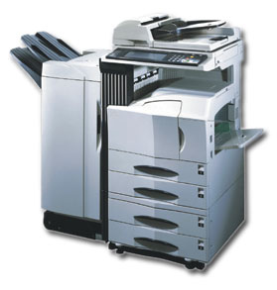
What are biosimilars?
A biosimilar medicine is a biological medicine that is developed to be similar to an existing biological medicine (the ‘reference medicine’)¹
Different terminologies used for biosimilar³:
Follow-on protein and follow-on biologic – preferred in USA
Subsequent Entry Biologic – preferred in Canada
Similar Biotherapeutic Product – preferred by WHO
X
Reference biological medicine
Biosimilars
Biosimilars may be similar but not identical to original biological medicine²
1. EMA/837805/2011, Questions and Answers on biosimilar medicines (similar biological medicinal medicine) 27 September 2012 http://www.ema.europa.eu/docs/en_GB/document_library/Medicine_QA/2009/12/WC500020062.pdf. Accessed on 26 December 2014. 2. Heinemann L, Hompesch M. J Diabetes Sci Technol. 2011;5(3):741-54. 3. Weise M, Bielsky MC, De SK, et al. Nat Biotechnol. 2011;29:690-693
Notes:
Biosimilars may be similar but not identical to original biological medicine X

Slide 4
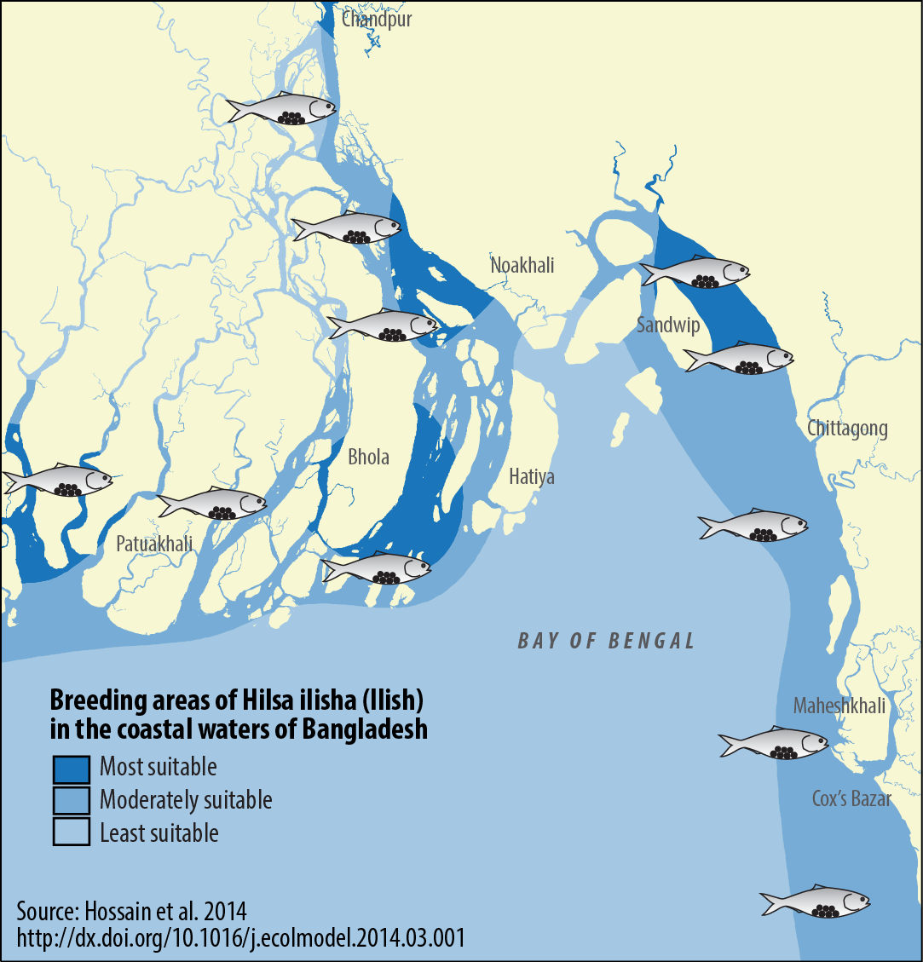
Biosimilars: Similar but not identical

Slide 5
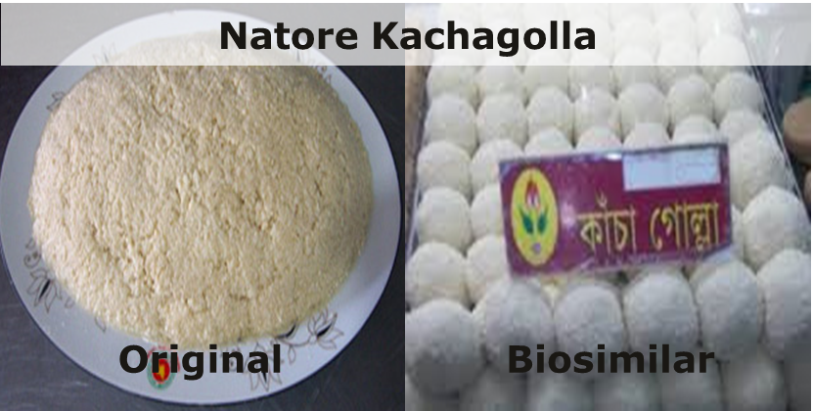
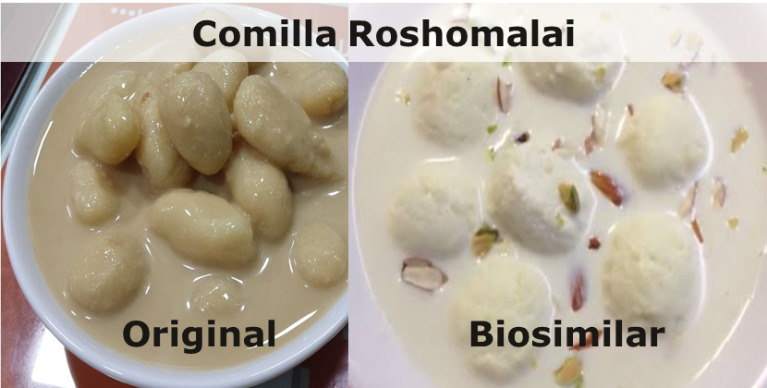
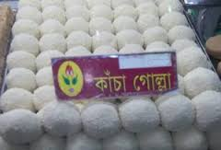
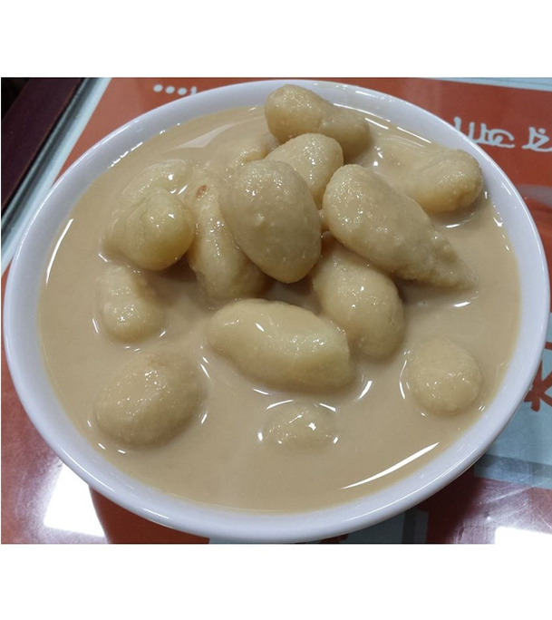
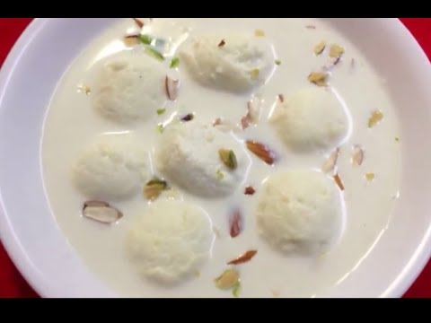
Key messages…
Natore Kachagolla
Original
Biosimilar
Similar does not mean Same
Comilla Roshomalai
Original
Biosimilar

Slide 6
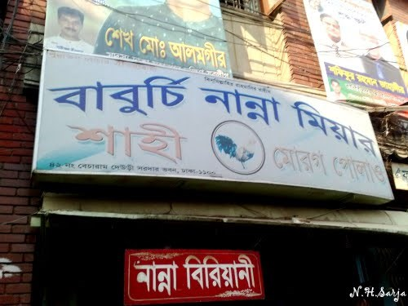
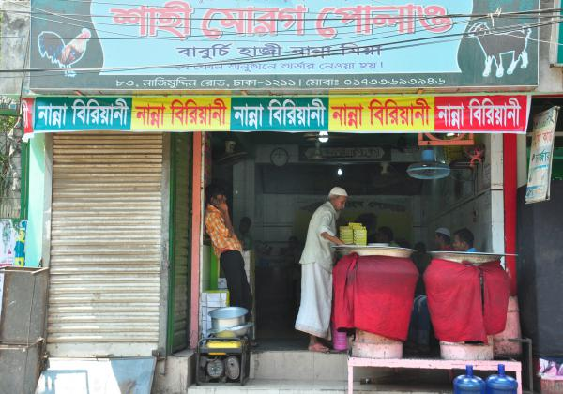
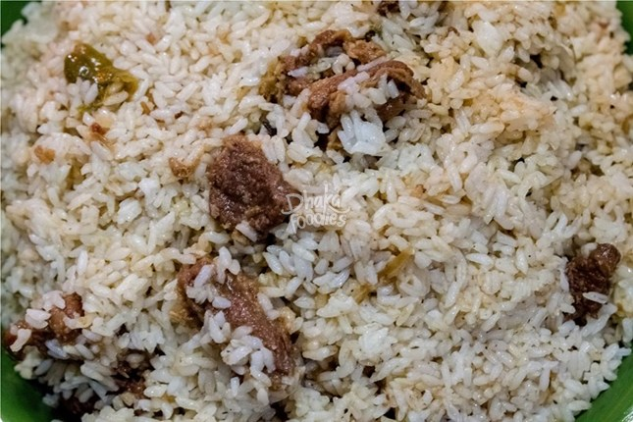
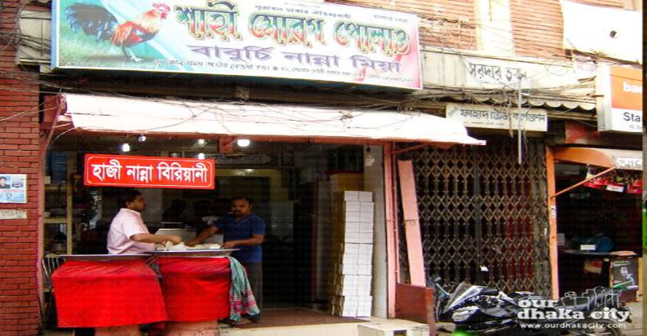

Slide 7
Generic vs. Biosimilar: Key Differences
Declerck PJ. GaBI J 2012;1:13-6
Sekhon BS and Saluja V. Biosimilars 2011;1:1-11
Notes:
Diab-00076152
Image/Figure Source:
Generic: Generic aspirin image by http://commons.wikimedia.org/wiki/User:Ragesoss - own work. Licensed under Creative Commons Attribution-Share Alike 3.0 Unported, 2.5 Generic, 2.0 Generic and 1.0 Generic via Wikimedia Commons - http://commons.wikimedia.org/wiki/File:Regular_strength_enteric_coated_aspirin_tablets.jpg.
License can be found at http://creativecommons.org/licenses/by-sa/2.5/deed.en, http://creativecommons.org/licenses/by-sa/2.0/deed.en, http://creativecommons.org/licenses/by-sa/1.0/deed.en
Biosimilar: “Small bottles of hope” by http://www.flickr.com/photos/vialbost. Licensed under Creative Commons Attribution-Share Alike 2.0 Generic via Flickr - http://www.flickr.com/photos/kb35/1644550531/in/photolist-f1uFuv-9qXrn5-3vjKzv-6ZH6MR-t3fKr-69Wzma-7ChdkS-4BMjcg-8KCC2c-hy3hgQ-4nYgaX-3z4M9-dnwiss-cNsPfU-cNsPBQ-4hm6hp-56Gybk-3BKubi-4ZcCqH-4FfSCc-9SFXnR-cormfS-RdSRq-7ctxAh-56LEs3-fC2mk-9VVqUx-6mCsk9-6tjVHp-2y1CEn-dcKxfS-haKVUD-p9CV5A-939L1k-7vZbRZ-3BPUTL-3BKyAZ-3BPX6L-3BPWjC-3BKvzv-3BPVBu-3BPS6Q-3BKxaZ-3BKuVX-3BPThm-6myioe-9soBxy-41m1J-6mCrwE-oeJTr8/. Lisence can be found at https://creativecommons.org/licenses/by/2.0/legalcode.
Key Points:
Biological medicines differ from small-molecule medicines in a number of important ways, as presented on the slide.^{1,2}
Eliminating impurities from biological products is generally more complex when compared to purification of chemical/generic drugs.² However, some biologics such as insulin are available in highly purified form.³
References:
Declerck PJ. Biologicals and biosimilars: a review of the science and its implications. GaBI J 2012;1(1):13-6.
Sekhon BS, Saluja V. Biosimilars: an overview. Biosimilars 2011;1:1-11.
Cefalu WT. Medical management of diabetes mellitus. New York, NY: Marcel Dekker, Inc; 2000.

Slide 8
Biologic Products Manufacturing
Large-scale production of proteins is generally performed using bacteria, yeast, or mammalian cell lines^{1,2}
All biological products that are currently available as biosimilarsª are produced using recombinant DNA technology³
ªApproved in the EU²
Sekhon BS and Saluja V. Biosimilars 2011;1:1-11
Owens DR et al. Diabetes Technol Ther 2012;14:989-96
European public assessment reports. http://goo.gl/x8LP6Z
Notes:
Diab-00076152
Image/Figure Source: Figure created for Eli Lilly and Company in December 2014.
Abbreviation: DNA=Deoxyribonucleic Acid
Key Points:
Large-scale synthesis of biological proteins must be performed in bacteria or yeast, or mammalian cell lines.¹
The process starts with the cloning of the desired gene into a deoxyribonucleic acid (DNA) vector using recombinant DNA technology^{1,4}
Host cell expression: The recombinant DNA vector is transferred into a bacterial, yeast, or mammalian host cell for expression.⁴ Cells expressing the desired protein are selected and cultured, this is known as “cell expansion.”⁵
Large quantities of the protein are produced by growing the cells in a bioreactor. The protein is recovered from this large-scale culture and purified.⁴
Formulation: Refers to a specialized solution, which is used to prepare the biologic into the final injectable form.⁶
Storage and handling: Since biological products are mostly proteins, their stability and activity may be affected by several factors including deamidation, oxidation, denaturation, and aggregation. Hence, stringent storage conditions are necessary.⁷
References:
Sekhon BS, Saluja V. Biosimilars: an overview. Biosimilars 2011;1:1-11.
Owens DR, Landgraf W, Schmidt A, et al. The emergence of biosimilar insulin preparations--a cause for concern? Diabetes Technol Ther 2012;14(11):989-96.
European Medicines Agency. European public assessment reports. http://goo.gl/x8LP6Z. Last accessed: 29 April 2016.
Mellstedt H, Niederwieser D, Ludwig H. The challenge of biosimilars. Ann Oncol 2008;19(3):411-9.
Prugnaud J-L, Trouvin J-H. Biosimilars: A new generation of biologics. Paris, France: Springer-Verlag; 2013.
BioPharm International. Guide to bioterminology 2nd edition. http://www.biopharminternational.com/biopharm/content/printContentPopup.jsp?id=362006. Last accessed: 13 Oct 2014.
Sharma B. Immunogenicity of therapeutic proteins. Part 3: impact of manufacturing changes. Biotechnol Adv 2007;25(3):325-31.

Slide 9
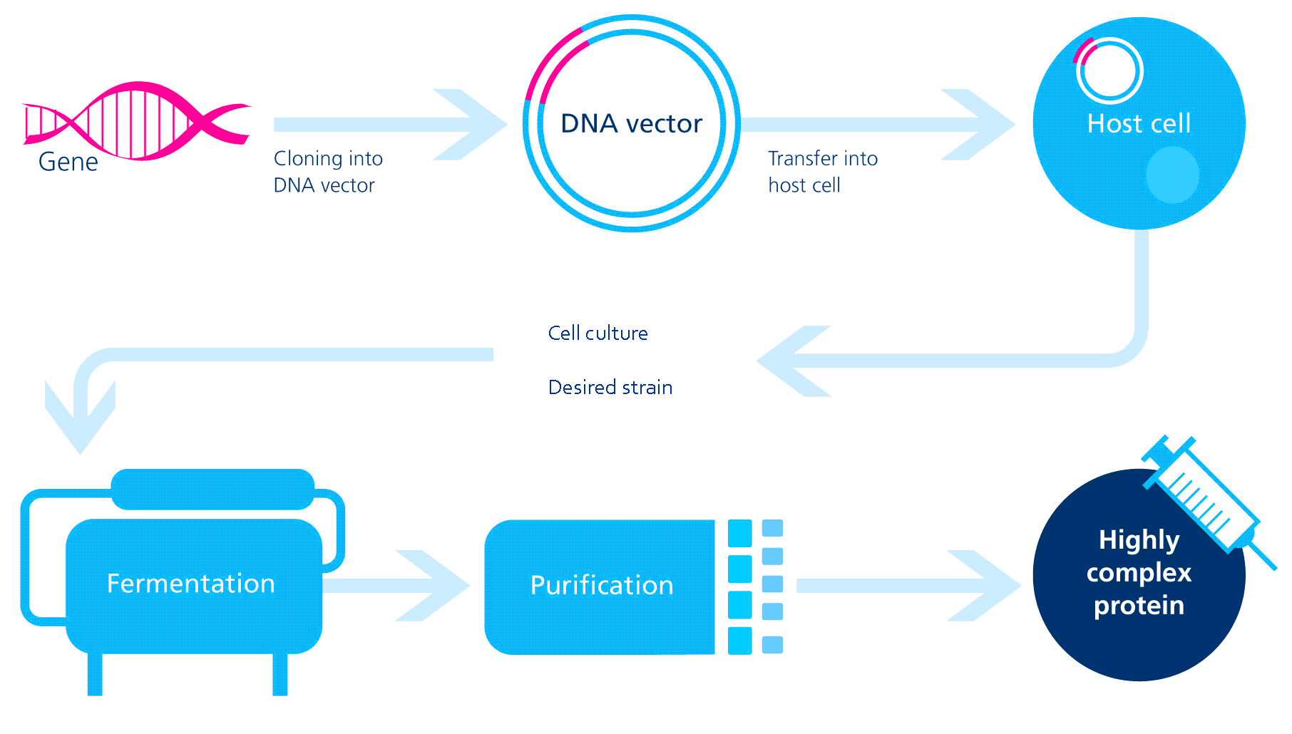
Manufacturing process of biological medicine
Process is product
Kramer et al Br J Diabetes Vasc Dis 2010:10:163–171; Kuhlmann M et al. Nephrol Dial Transplant. 2006;21(suppl 5):v4-v8
Notes:
Every single step is unique and crucial
Precise control and high quality of whole manufacturing process is necessary
Minor alterations in processes can affect the end product

Slide 10
Challenges in manufacturing biosimilar medicine: Opportunities for variation
Different vector
Different host cell
Different manufacturing processes may result in different medicine
Different cell expression system
Different cell line, growth media, bioreaction conditions
Different purification protocol
Different analytical tests
Different formulations
Kramer et al Br J Diabetes Vasc Dis 2010:10:163–171; Heinemann L et al. J Diabetes Sci Technol. 2014 ;8(1):6-13; Roger et al. J Clin Pharm Ther 2008;33(5):459–64
Notes:
Manufacturing details of biological product is a proprietary knowledge of innovator
Biosimilar manufacturers need to design entirely new manufacturing process

Slide 11
Biosimilarity Must be confirmed through Clinical Trial…. If not then the molecule can be considered as Non Comparable Biologics (NCBs)
originator
Non-Comparable
biosimilar
Comparable
biosimilar

Slide 12
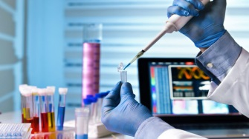
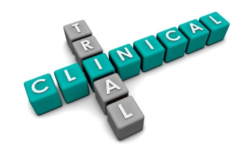
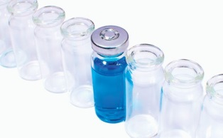
As per US-FDA, EMEA & WHO any biotech product (as Insulin) to be claimed as similar to Original Product has to pass through the following Steps
1.Pharmacokinetic & Pharmacodynamics studies (BE)
2. Randomized clinical trials evaluating safety & efficacy
Please look and ask for the followings before prescribing an insulin
A single pharmacokinetic / pharmacodynamic study
is not sufficient to prove bioequivalence
4. Insulin/IGF-1 receptor stimulation potency
3. Immunological safety studies
5. Toxicological studies
6. Impurity profile

Slide 13
Biosimilars Development Program^{1,2}
Analytical studies: Demonstrate that the biological product is highly similar to the reference product, notwithstanding minor differences in clinically inactive components
Animal studies (eg, toxicology)
A clinical study or studies (including the assessment of immunogenicity and PK or PD): Demonstrate safety, purity, and potency in one or more appropriate conditions of use for which reference product is licensed/intended to be used, for which licensure is sought for the biological product
CTs (Phase 3)
PK/PD (Phase 1)
Framework for approval by health authorities
Nonclinical
Biological Characterization
Physicochemical Characterization
Guidance for industry: Scientific considerations in demonstrating biosimilarity to a reference product. 2012. http://www.fda.gov/downloads/drugs/guidancecomplianceregulatoryinformation/guidances/ucm291134.pdf
Guideline on similar biological medicinal products containing biotechnology-derived proteins as active substance: non-clinical and clinical issues. http://www.ema.europa.eu/docs/en_GB/document_library/Scientific_guideline/2013/06/WC500144124.pdf
Notes:
Diab-00076152
Image/Figure Source: Figure created for Eli Lilly and Company in December 2014.
Abbreviations: CT=Clinical Trial; EMA=European Medicines Agency; FDA=US Food and Drug Administration; PD=Pharmacodynamics; PK=Pharmacokinetics
Key Points:
Both the FDA and the EMA require that the sponsor for a biosimilar drug must demonstrate similarity of the biosimilar drug to a previously approved reference medicinal product based on a comprehensive comparability exercise. A step-wise approach is recommended when evaluating the similarity of biosimilar and reference product.^{1,2}
Demonstration of similarity is primarily based on analytical studies (physico-chemical analysis, structural and functional characterization), comparative PK/PD studies, and clinical studies to demonstrate comparable efficacy and safety/immunogenicity.^{1,2}
The type and extent of analyses required to demonstrate similarity are specific for each product and may be influenced by the complexity of the reference product.^{1,2}
References:
US Food and Drug Administration. Guidance for industry: Scientific considerations in demonstrating biosimilarity to a reference product. http://www.fda.gov/downloads/drugs/guidancecomplianceregulatoryinformation/guidances/ucm291128.pdf. Last accessed: 3 Nov 2014.
European Medicines Agency. Guideline on similar biological medicinal products containing biotechnology-derived proteins as active substance: non-clinical and clinical issues. http://www.ema.europa.eu/docs/en_GB/document_library/Scientific_guideline/2013/06/WC500144124.pdf. Last accessed: 26 Sept 2014.

Slide 14
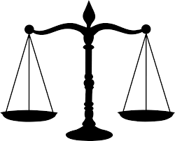
NCBs: opportunities and challenges
Cost savings
Improved access
The potential challenges
Notes:
The experience with Generic copies of small molecule drugs has shown a lot of cost savings (70%-80%) and improvement in the access of poor patients to these medications.
The same was expected from biosimilars, taking to consideration the fact that usually biologics are by far more expensive that small molecule drugs.

Slide 15
NCBs: opportunities and challenges
Initial payer perspective:
NCBs will generate 30% to 40% savings
Recent payers anticipation
A NCB will come in between 10% to 20% less than the cost of the branded manufacturer
Due to the complexity of bringing NCB to market
In Europe, biosimilars have often been just a 10% discount from the brand
Cost savings
Improved access
The potential drawbacks
P&T®. 2016;41(6):366–375.
Am J Manag Care 2015;21:S331–S340.
Haemophilia 2014;20(Suppl 4):29–35.
Notes:
The New biosimilars legislations especially in EU has facilitated the introduction of biosimilars.
However, the actual cost saving from biosimilars has been lower than expectations.
Initially it was expected that they will bring at least 30 % to 40% saving. But the actual numbers are around 10% to 20%.
And that is because of complexity of bringing a biosimilar to market as we saw.

Slide 16
NCBs: opportunities and challenges
Efficacy
Safety
Immunogenicity
Interchangeability
Cost savings
Improved access
The potential challenges
J Oncol Pharm Practice 2016;22(4):618–624.
Whitmore M. 2016. Future Bisomilars: Pros and Cons. Available at: http://www.hemophiliafed.org/news-stories/2016/01/future-bisomilars-pros-and-cons/
Notes:
And then there are these challenges with biosimilars:
Efficacy: At least one report has illustrated that biosimilars might not be as efficacious as their reference products.
An Irish study on Inflectra, a biosimilar used to treat irritable bowel disease, found that 29 percent of patients who took it required surgery versus 0 percent of patients who took Remicade (infliximab), its reference biologic. In addition, 80 percent of the Inflectra group required hospital readmission versus 5 percent of the Remicade group. And 93 percent of the Inflectra group showed an increase in C-reactive protein (CRP), while 100 percent of the Remicade group had a decrease in CRP.
Safety: In August 2015, Indian pharmaceutical and biotechnology firm Intas Biopharmaceuticals stopped distribution of its injectable, Razumab, after only two months on the market.
Razumab is an intended copy of Lucentis® (ranibizumab, Genetech). It is a Vascular Endothelial Growth Factor Inhibitor, used to treat macular degeneration, the drug caused adverse reactions such as inflammation in patients’ eyes.

Slide 17
Overview of Regulatory Requirements for Biosimilarity^{1,2}
The following are required from a biosimilar (regulatory requirements common to the US and EU):
Similarity demonstrated in preclinical in vitro and in vivo PD and toxicology studies
✓
Similarity demonstrated in clinical trials designed to assess PK and PD against standard acceptance limits
✓
No clinically meaningful differences in immunogenicity
✓
Head-to-head clinical trial(s) to detect relevant differences in efficacy or drug-related safetyª
✓
ªEfficacy/safety trial needed unless biosimilarity convincingly demonstrated by nonclinical, pharmacology, and immunogenicity studies
Guidance for Industry. Scientific considerations in demonstrating biosimilarity to a reference product. http://www.fda.gov/downloads/Drugs/GuidanceComplianceRegulatoryInformation/Guidances/UCM291128.pdf
Guideline on similar biological medicinal products containing biotechnology-derived proteins as active substance: non-clinical and clinical issues. http://www.ema.europa.eu/docs/en_GB/document_library/Scientific_guideline/2013/06/WC500144124.pdf
Notes:
Diab-00076152
Abbreviations: PD=Pharmacodynamic; PK=Pharmacokinetic
Key Points:
The following are required from a biosimilar:
High similarity demonstrated in preclinical in vitro and in vivo pharmacodynamic (PD) and toxicology studies.^{1,2}
High similarity demonstrated in clinical trials designed to assess pharmacokinetics (PK) and PD against standard acceptance limits.^{1,2}
No clinically meaningful differences in immunogenicity.¹
Head-to-head clinical trial(s) to detect relevant differences in efficacy or drug-related safety (efficacy/safety trial needed unless biosimilarity convincingly demonstrated by nonclinical, pharmacology and immunogenicity studies).²
References:
US Food and Drug Administration. Guidance for Industry. Scientific considerations in demonstrating biosimilarity to a reference product. http://www.fda.gov/downloads/Drugs/GuidanceComplianceRegulatoryInformation/Guidances/UCM291128.pdf. Last accessed: 26 Sept 2014.
European Medicines Agency. Guideline on similar biological medicinal products containing biotechnology-derived proteins as active substance: non-clinical and clinical issues. http://www.ema.europa.eu/docs/en_GB/document_library/Scientific_guideline/2013/06/WC500144124.pdf. Last accessed: 26 Sept 2014.

Slide 18
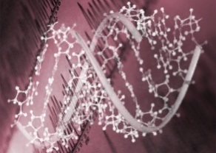
Potential challenges of NCBs
Unlike generic formulations of chemically synthesised drugs, it is not possible to make an identical copy of a biologic
Chemically-synthesised generic
Follow-on biologic
Simple process: mixing well-characterised chemicals and reagents in a series of controlled and predictable chemical reactions
Single, homogeneous end product
Complex process: harvesting of substances produced by constructed cells
Inherent heterogeneity as a result of complex manufacturing process
Hermans C. Podcast at WFH 2014. Available at: http://wfh.multilearning.com/wfh
Notes:
Unlike the process for synthesising chemicals, the process for manufacturing follow-on biologics is complex. It involves a number of technically demanding steps (see Slide 3), each of which is intricate, sensitive and specific to the particular biologic.
Even minor alterations in each step can lead to changes in the structure, stability and other quality attributes of the product, e.g differences in the way the protein is folded or post-translational modifications such as glycosylation.
This means that a high level of monitoring and quality testing is required: typically around 250 in-process tests are conducted for a biologic, compared with around 50 tests for a traditional chemical medicine.
One of the major challenges for companies developing follow-on biologics is that they do not have access to the master cell bank used by the originator – each company uses its own unique cell lines and consequently, develops its own unique manufacturing process.

Slide 19
Impact of manufacturing changes
Minor changes in manufacturing process may result in the following differences between NCB and reference medicine¹:
Variations in secondary and tertiary structure even though primary amino acid sequence may be similar
Different product related substances/impurities and process related impurities
Altered immunogenicity profile
Variations in PK and PD profile
Differences in storage stability
Minor variations in manufacturing process can have an impact on quality, safety and efficacy of end product
PK, pharmacokinetics; PD, pharmacodynamics
Heinemann L et al. J Diabetes Sci Technol. 2014 ;8(1):6-13.
Notes:
PK, pharmacokinetics; PD, pharmacodynamics

Slide 20
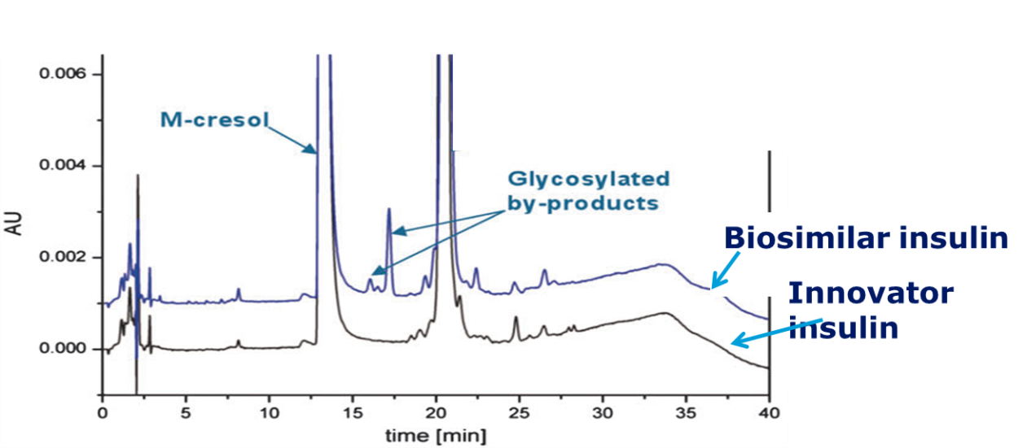
Immunogenicity:
Immunogenicity is always a concern for protein drugs, irrespective of whether they are originator drug or NCB¹
Immune response to biosimilar could be different from original reference product may be due to difference in²:
formulation
level of impurities,
stability profile,
storage conditions.
NCB insulin with similar insulin molecule but different impurity profile than innovator
1. DeVries J H et al Diabetes Obes Metab. 2014. doi: 10.1111/dom.12410. 2. Heinemann et al. Expert Opin. Biol. Ther. 2012;12(8):1009-1016, Owens DR et al. Diabetes Technol Ther. 2012;14(11):989-96.

Slide 21
Immunogenicity:
Undesirable immune response can alter the efficacy and safety of biological drug¹
Example²
Immunogenicity issues may only emerge after long-term exposure and only in certain people
Appropriate post-authorisation pharmacovigilance plan has to be implemented to capture the effect of immune response by NCBs
Minor change in formulation of one brand of Erythropoietin
Increased antibody-mediated neutralization of endogenoues EPO
Increased incidence of pure red cell aplasia ( PRCA)
Complete block in differentiation of red blood cells
1. DeVries J H et al Diabetes Obes Metab. 2014. doi: 10.1111/dom.12410. 2. Heinemann et al. Expert Opin. Biol. Ther. 2012;12(8):1009-1016,

Slide 22
Biosimilar insulin with similar PK profile but different PD profile than innovator insulin
Innovator
Biosimilar
Pharmacokinetics (PK)
Pharmacodynamics (PD)
PD studies demonstrated clinically meaningful differences
Clinical efficacy and safety study confirmed difference
PK, pharmacokinetics; PD, pharmacodynamics
Heinemann L, Hompesch M. J Diabetes Sci Technol. 2011;5(3):741-54.

Slide 23
Other risks associated with NCBs
Batch-to-batch variability and quality assurance
Measures to assess the “reproducibility” of manufacturing process have yet to be defined
Lack of long term safety data
Ensuring quality in distribution chain
Lack of experience in manufacturing biological medicine
Edelman S et al Curr Med Res Opin 2014 doi:10.1185/03007995.2014.952718 ;Heinemann et al. Expert Opin. Biol. Ther. 2012;12(8):1009-1016;
Owens DR et al. Diabetes Technol Ther. 2012;14(11):989-96; Heinemann L et al. J Diabetes Sci Technol. 2014 ;8(1):6-13.

Slide 24
Withdrawals/rejections
Europe (EMEA)
Marvel insulin application withdrawn because of irrelevant, poorly conducted, or missing studies
Brazil (ANVISA)
Registration of Wockhardt insulins: Wosulin-R, Wosulin-N, and Wosulin 30/70 was rejected by the regulatory body
South Asia
Complaints from patients: Wockhardt recalled 100,000 vials of its insulin products Wosulin 50/50 and Wosulin 30/70 at the request of the Indian regulatory authority.
Srilanka
All biosimilar insulins (Wockhardt, Biocon) withdrawn from Sri Lanka as they did not meet mandatory WHO GMP requirements
Different countries all over the world are taking action against NCB due to adverse events or lack of efficacy
Model Detailing Guide

Slide 25
Reminding Wockhardt stories…
Wockhardt looses Wosulin license
Forum rulling: Diabetic to get 1.5 lakh

Slide 26
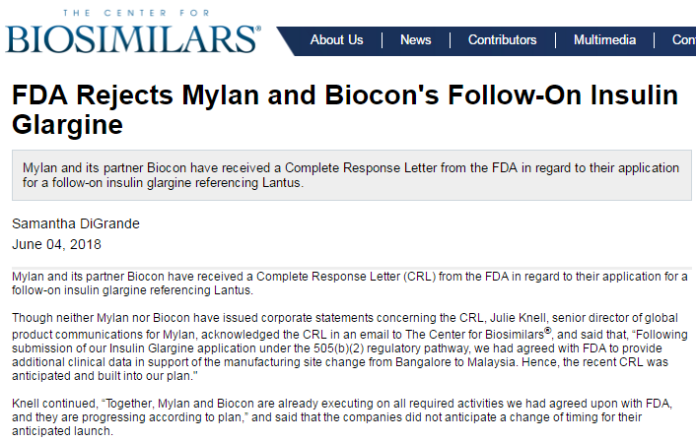
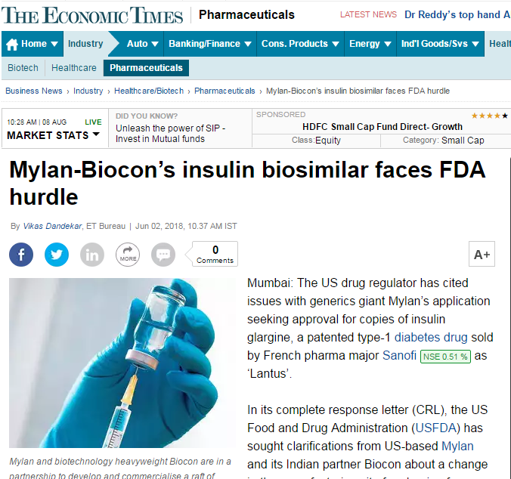

Slide 27
Unanswered Questions?
Long term safety data?
Data on immunogenicity?
Immune responses might not be detected in studies as suggested by regulators
Issue of substitution and interchangeability?
Use of devices especially insulin pen
Can biosimilar insulin cartridges be used with other reusable pens?
Who is responsible for educating patients when switching from one insulin pen to another?

Slide 28
Key messages…
Process is the Product
Originator insulin cannot be exactly copied, as
Different manufacturing processes may result in different medicine

Slide 29
Key messages…
As per FDA, EMA & WHO, all biosimilar products have to pass through following steps to be approved as originator
Pharmacokinetic and Pharmacodynamic studies
Clinical trials evaluating safety & efficacy
Immunological safety studies
Insulin/IGF-1 receptor stimulation potency
Toxicological studies
Immunity profile
So far, No Human and Modern Premix/Rapid acting insulin has been approved by FDA

Slide 30
Key messages…
Biosimilar Aspart and Aspart Mix are not approved any where in the world
Biosimilar Insulin
Not even in CHINA!
So, why take the risk??

Slide 31
Summary
Process is product in manufacturing biological medicines
NCBs may be similar but not identical to original reference medicine
Minor variations in insulin and growth hormone manufacturing can have significant effect on quality, safety and efficacy
Approvals of biosimilar medicine should be supported by a sufficiently robust data package and implementation of proper post-marketing surveillance
Prescribers should consider issues of manufacture, quality, formulation, reliability of supply before prescribing to patients
HbA_{1c}, glycated haemoglobin; IDegAsp, insulin degludec/insulin aspart

