Slide 1



Hirsutism: An update on Diagnosis and Treatment
Dr Nazmul Kabir Qureshi
MBBS, MD, FACE, FACP
Consultant (Endocrinology & Medicine)
National Healthcare Network (NHN)
Director, NHN Uttara EC
Diabetic Association of Bangladesh
Scientific & Research Secretary, Bangladesh Endocrine Society (BES)

Slide 2

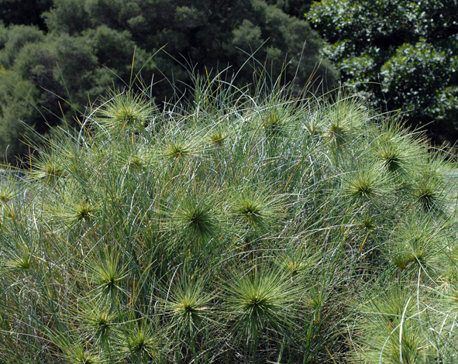
Latin hirsūtus: shaggy, hairy.
Lotus hirsutus | Hairy Canary Clover
Spinifex hirsutus Australian Hairy Spinifex

Slide 3
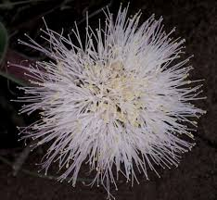
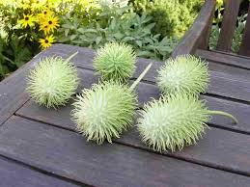
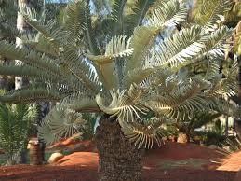

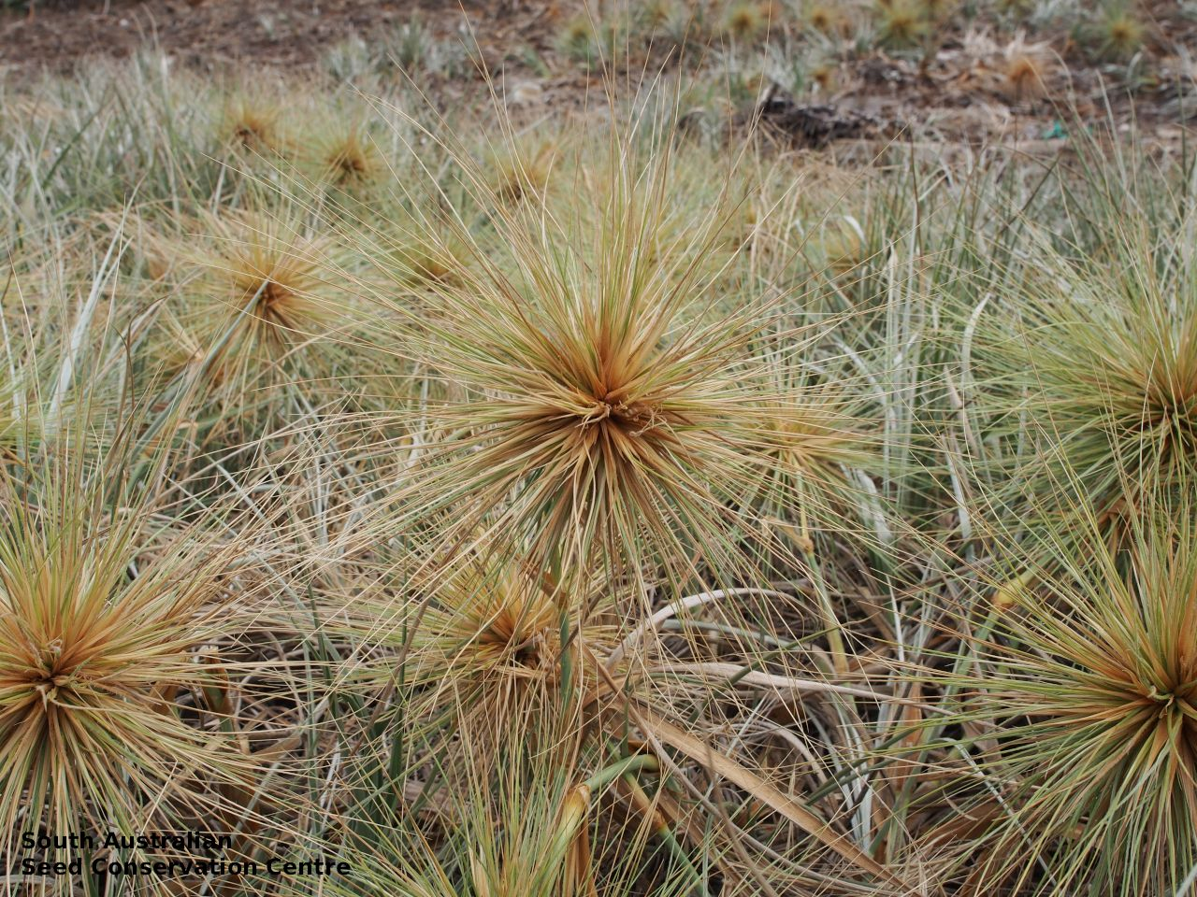
Latin hirsūtus: shaggy, hairy.

Slide 4
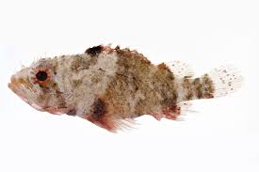
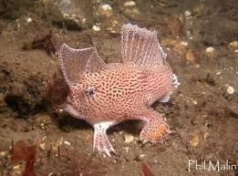
Spotted Hand fish
Brachionichthys hirsutus
Hairy Scorpion fish
Scorpaenodes hirsutus

Slide 5
Hirsutism
Excessive terminal hair in women
Appears in a male pattern (in androgen-dependent areas; i.e., sexual hair)
5-15% of re-productive aged women: ethnic backgrounds.
Martin et al. Guidelines on Hirsutism. J Clin Endocrinol Metab, April 2018, 103(4):1233–1257
Rosenfield RL. Clinical practice: hirsutism. N Engl J Med. 2005;353(24):2578–2588.
Azziz R. (May 2003). "The evaluation and management of hirsutism". Obstet Gynecol. 101 (5 pt 1): 995–1007

Slide 6
Hypertrichosis
Generalized excessive hair growth (terminal or vellus)
Non-sexual pattern
Predominantly on forearms or lower legs
Not caused by excess androgen (hyperandrogenemia may aggravate it).
Hereditary or result from certain medications(e.g., phenytoin, cyclosporine).
Martin et al. Guidelines on Hirsutism. J Clin Endocrinol Metab, April 2018, 103(4):1233–1257

Slide 7
Conversion of vellus hair to terminal hair
Hair growth regulation: growth factors, cytokines, sex steroids, thyroid and growth hormone.*
During puberty: androgen level increases:
  vellus follicles of specific areas develops into terminal hair,
  increase in sebum production,
  prolong anagen phase of body hair,
  shortens anagen phase of scalp hair.**
*Azziz R, Carmina E, Sawaya ME. Idiopathic hirsutism. Endocr Rev 2000;21:347–62.
**Rosenfield RL. Clinical practice: hirsutism. N Engl J Med. 2005;353(24):2578–2588

Slide 8
Conversion of vellus hair to terminal hair
Level and duration of exposure to androgens,
local 5-alpha-reductase activity, converts T to DHT
Intrinsic sensitivity of the hair follicle to androgen action
Hawryluk EB, English III JC. Female adolescent hair disorders. J Pediatr Adolesc Gynecol 2009;22(4):271–81.

Slide 9
Pathogenesis
Vellus Hair
Results from: Excess androgen levels >increased terminal hair growth in androgen-sensitive sites (e.g., upper lip, chin, chest, back, and upper abdominal area). *,**
Sensitivity of the hair follicle:*
  Conversion of T to DHT by the enzyme 5a-reductase and [3 β HSD, 17βHSD]
  And binding of these molecules to the androgen receptor of hair follicle located in dermal papilla
Sex specific Hairs
Androgens
Terminal Hair
*Martin et al. Guidelines on Hirsutism. J Clin Endocrinol Metab, April 2018, 103(4):1233–1257
**Azziz R, Carmina E, Sawaya ME. Idiopathic hirsutism. Endocr Rev 2000;21:347–62.

Slide 10
Score & Androgen
≥80%, Hirsutism is due to androgen excess.*
Androgen-dependent pilosebaceous follicle response to androgen varies considerably.**
Severity/Score may not always correlate with androgen level.**
*Ehrmann DA, et al. Detection of functional ovarian hyperandrogenism in women with androgen excess. N Engl J Med. 1992;327(3):157–162
**Reingold SB, Rosenfield RL. The relationship of mild hirsutism or acne in women to androgens. Arch Dermatol. 1987;123(2):209–212.
**Lobo RA, Goebelsmann U, Horton R. Evidence for the importance of peripheral tissue events in the development of hirsutism in polycystic ovary syndrome. J Clin Endocrinol Metab. 1983;57(2): 393–397.

Slide 11
Etiology

Slide 12
Etiology
PCOS | 70-80%
Ovarian Tumors (sex-cord stromal tumor, Sertoli-Leydig cell tomur | <1%*
Stromal hyperthecosis | rare
CAH (classical 1%; NCCAH 3%) | 4.2%*
Cushing’s disease | <1%*
Adrenal Tumors (adenoma, 50% carcinoma) | 0.2%- <1%*
Idiopathic | 5- 20%
Martin et al. Guidelines on Hirsutism. J Clin Endocrinol Metab, April 2018, 103(4):1233–1257
*Franks S. The investigation & management of hirsutism. Fam Plann Reprod Health Care 2012;38:182–186.

Slide 13
Etiology…others
Growth hormone excess | Rare
Insulin resistance | Rare
Hyperprolactinoma | Rare
Medications:
T inj, creams, patches, topical T used by partners
GCs, anabolic steroid
Valproic acid, Cyclosporin, Progestins, Diazoxide, Phenytoin, danazol,
Martin et al. Guidelines on Hirsutism. J Clin Endocrinol Metab, April 2018; 103(4):1233–1257
Loriaux L, et al. An Approach to the Patient with Hirsutism. J Clin Endocrinol Metab 2012;97(9):2957-2968

Slide 14
Pcos
Excessive LH release > Hyperandrogenemia*
Hyperinsulinemia> increase GnRH) pulse frequency, LH over FSH dominance, androgen production and decrease sex hormone-binding globulin (SHBG)*
Insulin itself stimulates ovarian theca cells to overproduce androgens.$
Adiposity: obese and overweight> more hirsute.**
Weight loss: improvement of symptom.***
*Mayo Clinic Staff. Polycystic ovary syndrome (PCOS) [Internet]. Cited 2011 November 15.
**Barber TM, McCarthy MI, Wass JA, et al. Obesity and polycystic ovary syndrome. Clin Endocrinol (Oxf) 2006;65:137–145.
***Kiddy DS, Hamilton-Fairley D, Bush A, et al. Improvementin endocrine and ovarian function during dietary treatment ofobese women with polycystic ovary syndrome. Clin Endocrinol(Oxf) 1992;36:105–111.
$. Franks S, Gilling-Smith C, Watson H, et al. Insulin action in the normal and polycystic ovary. Endocrinol Metab Clin North Am 1999;28:361–378.

Slide 15
CAH
The commonest: non-classical (late-onset) congenital adrenal hyperplasia (NCCAH) due to deficiency of the 21-hydroxylase enzyme.*
NCCAH is difficult to distinguish clinically from PCOS and majority of women with biochemically proven CAH also have polycystic ovaries on ultrasound examination.
Increased production of 17 OH P, androstenedione.
Bidet M, et al. Clinical and molecular characterization of a cohort of 161 unrelated women with nonclassical congenital adrenal hyperplasia due to 21-hydroxylase deficiency and 330 family members. J Clin Endocrinol Metab 2009;94:1570–1578.

Slide 16
CAH
Classical (early-onset, salt-losing, 21-hydroxylase deficiency, 11-hydroxylase deficiency, and 3-beta hydroxysteroid dehydrogenase deficiency] CAH is usually diagnosed in infancy (or even in utero) and early treatment can prevent development of symptoms and signs of androgen excess. *
Androgen excess, hirsutism, genital ambuguity, cortisol deficiency.
Loriaux L, et al. An Approach to the Patient with Hirsutism. J Clin Endocrinol Metab 2012;97(9):2957-2968

Slide 17
Idiopathic
Half of all women with mild hirsutism have idiopathic hirsutism.
A diagnosis of exclusion.
  normal Serum androgen concentrations,
  no menstrual irregularities,
  and no identifiable cause of hirsutism.
80% regarded as idiopathic> found with PCO.*
*Azziz R, Carmina E, Sawaya ME. Idiopathic hirsutism. Endocr Rev 2000;21:347–62.

Slide 18
Adrenal tumors
Rare cause, most are adrenal carcinomas.
Typically cause hypercortisolism and excess androgen secretion (dihydroepiandrostenedione [DHEA] and DHEA sulfate [DHEA-S]).
Patients typically present with rapid onset of Cushing's syndrome and hyperandrogenism.
J. Mihailidis et al. International Journal ofWomen's Dermatology 2017;3: S6–S10

Slide 19
Cushing’s
Cushing’s disease: ACTH-pituitary adenoma resulting in excessive secretion of not only cortisol, but also adrenal androgens.
Hirsutism along with weight gain, hypertension, rounding of the face, abdominal striae, and irregular menstruation.
J. Mihailidis et al. International Journal ofWomen's Dermatology 2017;3: S6–S10

Slide 20
Evaluation

Slide 21
Evaluation
Though, typically present cosmetic concern…..
Need to identify underlying endocrine disorder.
J. Mihailidis et al. International Journal ofWomen's Dermatology 2017;3: S6–S10

Slide 22
Evaluation: History
Age/Duration/ Severity | Onset near puberty, gradual, Mild to moderate | PCOS, idiopathic, NCCAH
 | Recent onset | Androgen secreting tumor
 | Worsening, excessive
 | Onset later in life rather near puberty
Menstrual history | Abnormality | PCOS, NCCAH
 | Regular | idiopathic
Akter N, Qureshi NK. Hirsutism- evaluation and treatment. Delta Med Col J. Jan 2016;4(1):35–44
J. Mihailidis et al. International Journal ofWomen's Dermatology 2017;3: S6–S10
Martin et al. Guidelines on Hirsutism. J Clin Endocrinol Metab, April 2018, 103(4):1233–1257

Slide 23
Evaluation/ History
Infertility
Obesity
Medication used | e.g.; valproic acid raises T level.
Family history | Other members have hirsutism, acne, infertility, diabetes mellitus and cardiovascular disease
Ethnicity: Mediterranean | Greater quantity of body hair, compared to Asian
J. Mihailidis et al. International Journal ofWomen's Dermatology 2017;3: S6–S10
Akter N, Qureshi NK. Hirsutism- evaluation and treatment. Delta Med Col J. Jan 2016;4(1):35–44

Slide 24
Nine body areas sensitive to androgen is assigned to score
0 = no hair, to 4 = frankly virile
Ferriman D, Gallwey JD. Clinical assessment of body hair growth in women. J Clin Endocrinol Metab. 1961;21(11):1440–1447.
Hatch R, Rosenfield RL, Kim MH, Tredway D. Hirsutism: implications, etiology, and management. Am J Obstet Gynecol.1981;140(7):815–830.

Slide 25
Nine body areas sensitive to androgen is assigned to score
0 = no hair, to 4 = frankly virile
Ferriman D, Gallwey JD. Clinical assessment of body hair growth in women. J Clin Endocrinol Metab. 1961;21(11):1440–1447.
Hatch R, Rosenfield RL, Kim MH, Tredway D. Hirsutism: implications, etiology, and management. Am J Obstet Gynecol.1981;140(7):815–830.

Slide 26
Hirsutism Scoring: Ferriman–Gallwey Score
United States and United Kingdom black or white women, ≥8*
Mediterranean, Hispanic, and Middle Eastern women: ≥9 to 10 [1]
South American women: ≥6 [2]
Han Chinese Asian women a range: ≥2 [1]
Southern Chinese Asian women: ≥7 [3,4]
*Escobar-Morreale HF, et al. Epidemiology, diagnosis and management of hirsutism: a consensus statement by the Androgen Excess and Polycystic Ovary Syndrome Society. Hum Reprod Update.2012;18(2):146–170.
1. Escobar-Morreale HF, et al. Epidemiology, diagnosis and management of hirsutism: a consensus statement by the Androgen Excess and Polycystic Ovary Syndrome Society. Hum Reprod Update.2012;18(2):146–170
2. Rios X, et al. Clinical assessment of body hair in Colombian women: determining the cutoff score that defines hirsutism. Biomedica. 2013;33(3):370–374.
3. Zhao X, et al. Defining hirsutism in Chinese women: a cross-sectional study. Fertil Steril. 2011;96(3):792–796.
4. Li R, et al. Epidemiology of hirsutism among women of reproductive age in the community: a simplified scoring system. Eur J Obstet Gynecol Reprod Biol. 2012;163(2):165–169.

Slide 27
Evaluation/ Sign: FG Score
Mild | Moderate/Severe | Severe
8-15 | >15 to 25 | >25
Benign |  | Androgen producing tumor
Martin et al. Guidelines on Hirsutism. J Clin Endocrinol Metab, April 2018, 103(4):1233–1257
J. Mihailidis et al. International Journal ofWomen's Dermatology 2017;3: S6–S10

Slide 28
Ferriman–Gallwey Score
The normal score is lower in some Asian populations and higher in Mediterranean populations.*
Lower score can be clinically important.**
Even minimal degrees of unwanted hair are often associated with hyperandrogenemia when menstrual irregularity is present.**
Locally excessive hair growth (score <8) is a common normal variant.*
*Martin et al. Guidelines on Hirsutism. J Clin Endocrinol Metab, April 2018, 103(4):1233–1257
**Souter I et al. Ther prevelence of androgen excess among patients with minimal unwanted hair growth. Am J Obstet Gynecol. 2004;191(6): 1914–1920.

Slide 29
Ferriman–Gallwey Score: Limitations
Subjective nature.
Failure to account for a locally high score that does not raise total score to an abnormal extent.
Lack of consideration of some androgen sensitive areas: sides of the face from the hairline to below the ear (sideburns) and the buttocks.
Martin et al. Guidelines on Hirsutism. J Clin Endocrinol Metab, April 2018, 103(4):1233–1257

Slide 30
Other Signs
Signs of virilization
Male pattern hair loss, deepening of voice, acne, increased muscle mass, clitoromegaly | Androgen producing tumor
Obesity, acanthosis nigricans, acne | PCOS
Cushingoid | CD
Pelvic mass | Tumor
Martin et al. Guidelines on Hirsutism. J Clin Endocrinol Metab, April 2018, 103(4):1233–1257
J. Mihailidis et al. International Journal ofWomen's Dermatology 2017;3: S6–S10

Slide 31
Features: Hyperandgrogenic Endocrine Disorders
Menstrual irregularity
Infertility
Galactorrhea
Central obesity
Acanthosis nigricans
Sudden-onset or rapid-progression hirsutism
Hirsutism progression in spite of therapy.
Clitoromegaly, other virilizing sign
Martin et al. Guidelines on Hirsutism. J Clin Endocrinol Metab, April 2018, 103(4):1233–1257

Slide 32
Investigations
Hirsutism is a clinical diagnosis.
Apart for cosmetic issue, it have implications for fertility, medical risks, and genetic counseling.
Variety of approaches are used to diagnose.
Uncertainty prevails regarding
  Cost effectiveness, acceptability to patients, and the impact on outcomes.
Martin et al. Guidelines on Hirsutism. J Clin Endocrinol Metab, April 2018, 103(4):1233–1257

Slide 33
Investigations
Mild, chronic hirsutism, regular cycles | Testosterone, pelvic ultrasonography/ No tests?
Moderate hirsutism with or without cycle disturbance | Testosterone, LH, FSH, ultrasonography
Severe hirsutism, short history, testosterone >5 nmol/l | DHEAS, 17-OHP, dexamethasone suppression test, 24-hour urine free cortisol, ovarian and/or adrenal imaging, fasting glucose/insulin
Extensive investigation: reserved for more severe cases and/or those with a short history of hirsutism or with markedly elevated serum testosterone > twice upper limit of normal range 17-hydroxyprogesterone usually measured before and during a short Synacthen test.
Martin et al. Guidelines on Hirsutism. J Clin Endocrinol Metab, April 2018, 103(4):1233–1257
Fam Plann Reprod Health Care 2012;38:182–186. doi:10.1136/jfprhc-2011-100175

Slide 34
Clinical Practice: T
Total Testosterone: in all women with an abnormal hirsutism score.
Early morning serum total and free testosterone: while
serum total testosterone normal and
sexual hair growth is moderate/severe
sexual hair growth is mild but there is clinical evidence of a hyperandrogenic endocrine disorder
Martin et al. Guidelines on Hirsutism. J Clin Endocrinol Metab, April 2018, 103(4):1233–1257

Slide 35
T
T > 150 to 200 ng/dl: suspected T secreting Ovarian tumor* [10 nmol/l]
Routine measurement of SHBG and calculation of the free testosterone index (FTI) (testosterone/SHBG×100) are not indicated in hirsutism
Eumenorrheic with unwanted local hair growth without abnormal score
  Against testing for androgen: Low likelihood of medical disorder.
*Friedman et al., 1985; Meldrumand Abraham, 1979; Moltz et al., 1984).
Martin et al. Guidelines on Hirsutism. J Clin Endocrinol Metab, April 2018, 103(4):1233–1257

Slide 36
17 OH P
Early morning 17-hydroxyprogesterone (in the follicular phase or on a random day for those with amenorrhea or infrequent menses): NCCAH due to 21-hydroxylase deficiency
  All Hyperandrogenemic cases.
  total and free testosterone normal but having a risk of CAH (positive family history, member of a high-risk ethnic group).
[The definitive tests for CAH: 17-OHP before and after stimulation with synthetic ACTH (a short Synacthen test and genetic screening.]
Martin et al. Guidelines on Hirsutism. J Clin Endocrinol Metab, April 2018, 103(4):1233–1257
J Fam Plann Reprod Health Care 2012;38:182–186. doi:10.1136/jfprhc-2011-100175

Slide 37
Others
Adrenal hyperandrogenism: DHEA sulphate
Cushing’s syndrome: dexamethasone suppression test, 24-hour urine free cortisol
Thyroid dysfunction: TSH, FT4
Imaging for adrenal(USG, CT) & Ovarian etiology (TVS USG)
Others: Acromegaly, Hyperprolactinoma:
Martin et al. Guidelines on Hirsutism. J Clin Endocrinol Metab, April 2018, 103(4):1233–1257

Slide 38
Rarely needed for the rarest conditions
Serum androstenedione (the immediate precursor for testosterone)
Response to cosyntropin of
  17-hydroxyprogesterone,
  DHEA sulphate (>700 mcg/dl: adrenocortical carcinoma)
  17-hydroxypregnenolone,
  11-deoxycortisol
Escobar-Morreale HF, et al. Epidemiology, diagnosis and management of hirsutism: a consensus statement by the Androgen Excessand Polycystic Ovary Syndrome Society. Hum Reprod Update.2012;18(2):146–170.
Goodman NF, et al; American Association of Clinical Endocrinologists Hyperandrogenic Disorders Task Force. American Association of Clinical Endocrinologists medical guidelines for the clinical practice for the diagnosis and treatment of hyperandrogenic disorders. Endocr Pract. 2001;7(2):120–134
Practice Committee of the American Society for ReproductiveMedicine. The evaluation and treatment of androgen excess. Fertil Steril. 2006;86(5, Suppl 1):S241–S247.
Pugeat M, et al. French Endocrine Society. Recommendations for investigation of hyperandrogenism. Ann Endocrinol . 2010;71(1):2–7.

Slide 39
Rarely needed for the rarest conditions
genotyping to exclude rare forms of congenital adrenal hyperplasia
DST to suppress androgens arising from a functional adrenal source
TVS: with hyperandrogenemia (T >150 ng/ml) absence of follicles and or the polycystic ovarian morphology supports the diagnosis of hyperthecosis.
Escobar-Morreale HF, et al. Epidemiology, diagnosis and management of hirsutism: a consensus statement by the Androgen Excessand Polycystic Ovary Syndrome Society. Hum Reprod Update.2012;18(2):146–170.
Goodman NF, et al; American Association of Clinical Endocrinologists Hyperandrogenic Disorders Task Force. American Association of Clinical Endocrinologists medical guidelines for the clinical practice for the diagnosis and treatment of hyperandrogenic disorders. Endocr Pract. 2001;7(2):120–134
Practice Committee of the American Society for ReproductiveMedicine. The evaluation and treatment of androgen excess. Fertil Steril. 2006;86(5, Suppl 1):S241–S247.
Pugeat M, et al. French Endocrine Society. Recommendations for investigation of hyperandrogenism. Ann Endocrinol . 2010;71(1):2–7.

Slide 40
Adapted from: Martin KA, et al. Evaluation and treatment of hirsutism in premenopausal women: an endocrine society clinical practice guideline. J Clin Endocrinol Metab.2008;93(4):1105–1120.

Slide 41
Treatment

Slide 42
Patient-important
Hirsutism
Unwanted sexual hair growth of any degree
Causing sufficient distress, seeking treatment.
Martin et al. Guidelines on Hirsutism. J Clin Endocrinol Metab, April 2018, 103(4):1233–1257

Slide 43
Hirsutism: Treatment
Specific treatment for underlying etiology
Two main Approaches (used individually or in combination)
Pharmacological therapies
Direct hair removal (Physical methods)

Slide 44
Direct Hair Removal
Temporary methods of hair removal (Cosmetic methods):
Epilation (extract hair to above the bulb): Plucking, waxing: safe, inexpensive, no increase in hair diameter, discomfort, scarring, folliculitis, hyperpigmentation.
Depilation (remove hair shaft from skin surface):
  Shaving (does not affect growth rate or hair diameter,
  Chemical depilatory: thioglycolate containing sulphar, disrupt di-sulphide bond of hair: unpleasant hair, irritant dermatitis
[Bleaching: hydrogen peroxide, sulphar: masking undesired hair, irritation, pruritus, skin discoloration]
Martin et al. Guidelines on Hirsutism. J Clin Endocrinol Metab, April 2018, 103(4):1233–1257

Slide 45
Direct Hair Removal
Permanent methods of hair reduction:
Attaining at least 30% reduction of terminal hair and sustaining this reduction for a period longer than growth cycle (4 to 12 months) [FDA].
Photo-epilation: brown, black, auburn hair, large treatment area.
Electrolysis: white, blond hair, small treatment area.
Martin et al. Guidelines on Hirsutism. J Clin Endocrinol Metab, April 2018, 103(4):1233–1257

Slide 46
Photo-epilation
Four types of LASER: ruby, alexandrite, diode, NdYAG
A meta-analysis of 24 prospective trials [1998 and 2003 ]: after 6 months [Sadighha A, Lasers Med Sci. 2009;24(1):21–25.
Diode | Alexandrite | Ruby | Nd:YAGlasers
57.5%, | 54.0%, | 52.8% | 42.3%
Intense Pulsed light (IPL): 500-1200 nm wave length. [Altshuler GB, Lasers Surg Med. 2001;29(5):416–432.].

Slide 47
IPL vs LASER
6 months after 4 to 6 photoepilation | 27% to 40% for IPL | 34% for diode laser | 46% for alexandrite laser
Haak CS, et al. Hair removal in hirsute women with normal testosterone levels: a randomized controlled trial of long-pulsed diode laser vs. intense pulsed light. Br J Dermatol. 2010;163(5):1007–1013.
Nilforoushzadeh MA, et al. Comparison between sequentional treatment with diode and alexandrite lasers versus alexandrite laser alone in the treatment of hirsutism. J Drugs Dermatol. 2011;10(11):1255–1259.
McGill DJ, et al. A randomised, split-face comparison of facial hair removal with the alexandrite laser and intense pulsed light system. Lasers Surg Med. 2007;39(10):767–772.

Slide 48
Electrolysis
Electrolysis: fine electrode inserted into hair follicles. *
Galvanic technique: electrochemical reaction> toxic product in follicle.
Thermolysis technique: heat in follicle.
Blend: combination of both> more effective, painful. *, **
*Richards RN, Meharg GE. Electrolysis: observations from 13 years and 140,000 hours of experience. J Am Acad Dermatol.1995;33(4):662–666.
**Wagner RF Jr, Flores CA, Argo LF. A double-blind placebo controlled study of a 5% lidocaine/prilocaine cream (EMLA) for topical anesthesia during thermolysis. J Dermatol Surg Oncol. 1994;20(2):148–150.

Slide 49
Photo-epilation vs Electrolysis
IPL vs Electrolysis: 24/25 preferred IPL. (Harris K, J Dermatolog Treat. 2014;25(2):169–173).
LASER | Electrolysis:
30 seconds; 60 times faster | 30 minutes
74 % reduction of terminal hair | 35% reduction of terminal hair
Go¨ rgu¨ M, Comparison of alexandrite laser and electrolysis for hair removal. Dermatol Surg. 2000;26(1):37–41.
Nd YAG lasers are effective and low risk of epidermal injury and pigmentary side effects. [Rao K, . Long-pulsed Nd:YAG laser-assisted hair removal in Fitzpatrick skin types IV-VI. Lasers Med Sci. 2011;26(5) 623–626.]

Slide 50
Melanin pigment is necessary for photoepilation; white or blond hair not amenable to treatment.
Tanned or pigmented skin are at higher risk than fair skin (as light pass through epidermis and dermal papillae).
Adverse effects: Inflammation, burns, blistering, hypopigmentation, hyperpigmentation, scarring. [Somani N, Turvy D. Hirsutism: an evidence-based treatment update. Am J Clin Dermatol. 2014;15(3):247–266.]
PH: unknown reason, Medtr Middle Eastern. [Desai S, Paradoxical hypertrichosis after laser therapy: a review. Dermatol Surg. 2010; 36(3):291–298.]

Slide 51
Pharmacological therapies
Combined oral estrogen-progestin contraceptives (OC)
Antiandrogens
Other therapies: Insulin sensitizing agents,, Steroids, topical treatment, GnRH agonist.

Slide 52
OCs
Combination of EE with progestin with low androgenic property.
Estrogen: increase SHBG, decrease Free T and other androgens
Also suppress adrenal androgens by interfering with synthesis.
Progestin: suppress LH>ovarian androgen production
J. Mihailidis et al. / International Journal ofWomen's Dermatology 3 (2017) S6–S10

Slide 53
OCs
52 women with PCOS were randomized : 12months
0.035 mg of ethinyl estradiol with 2 mg of CPA : median decline FG score of 35%
0.03 mg of ethinyl estradiol with 3mg of drosperinone: 18% median decline
Concluded that OCPs with
CPA are more effective for the treatment of hirsutism in PCOS
[Kahraman et al., 2014]

Slide 54
One OC is not suggested over another one as initial therapy, all OCs appear to be equally effective for hirsutism, and the risk of side effects is low.
Higher risk for VTE (e.g., those who are obese or over age 39 years),
OC containing the lowest effective dose of ethinyl estradiol (EE) (usually 20 mcg) and a low-risk progestin.
Martin et al. Guidelines on Hirsutism. J Clin Endocrinol Metab, April 2018, 103(4):1233–1257
*Vinogradova Y, Coupland C, Hippisley-Cox J. Use of combined oral contraceptives and risk of venous thromboembolism: nested case-control studies using the QResearch and CPRD databases. BMJ. 2015;350

Slide 55
Antiandrogens
Spironolactone: 100–200 mg/d [given in divided doses twice daily]
Finasteride: 2.5–5 mg/d
Cyproterone: 50–100 mg/d on menstrual cycle days 5–15, with EE 20–35 mg on days 5–25
Flutamide: 250–500 mg/d (high dose) 62.5 to #250 mg/d (low dose

Slide 56
Spironolactone:
Aldosterone antagonist related structurally to progestins.
Competes with dihydrotestosterone (DHT) for binding androgen receptors.
Inhibitory effect on 5- alpha reductase and,
at doses >200 mg per day, inhibits action of various enzymes involved in androgen biosynthesis.
Starting dose: 50 mg twice daily, increased to 100 mg twice daily if needed.
Side effects: hyperkalemia, irregular menses, teratogenicity.
J. Mihailidis et al. / International Journal ofWomen's Dermatology 3 (2017) S6–S10

Slide 57
Finasteride
Type-2, 5-α reductase inhibitor.
Only a partial inhibitory effect is anticipated as it does not affect type-1, 5- α reductase.
Usual dose: 5 mg per day, (7.5 mg per day). When used in women of reproductive age, it should be used with effective contraception.
feminization of a male fetus because DHT is involved in the development of male external genitalia.
J. Mihailidis et al. / International Journal ofWomen's Dermatology 3 (2017) S6–S10

Slide 58
Cyproterone
17-hydroxyprogesterone acetate derivative with strong progestogenic effects.
Decreases serum LH and ovarian androgen production, Competes with DHT for the androgen receptor.
Used as low-dose of 2mg as the progestin part of combination oral contraceptives,
Higher dose of 12.5 to 100 mg per day as monotherapy.
J. Mihailidis et al. / International Journal ofWomen's Dermatology 3 (2017) S6–S10

Slide 59
Flutamide is a nonsteroidal antiandrogen.
It blocks androgen receptors, preventing the binding of DHT.
Usual dose is 250 to 750 mg per day, which is equal in efficacy to spironolactone 100 mg/day or finasteride 5 mg/day.
Flutamide is associated with dose dependent hepatotoxicity.
It is not recommended as first- line therapy
J. Mihailidis et al. / International Journal ofWomen's Dermatology 3 (2017) S6–S10

Slide 60
Meta-analysis five trial: comparing antiandrogen therapy to placebo.
Antiandrogens (spironolactone, finasteride, and flutamide) significantly reduced hirsutism, lowering FG scores by 3.9 (95% CI [2.3, 5.4]),
no apparent difference among the three medications
Sahin Y, Bayram F, Kelestimur F, Muderrs I. Comparison of cyproterone acetate plus ethinyl estradiol and finasteride in the treatment of hirsutism. J Endocrinol Invest 1998; 21:348–52.
Swiglo BA, Cosma M, Flynn DN, Kurtz DM, Labella ML, Mullan RJ, et al. Clinical review: antiandrogens for the treatment of hirsutism: a systematic review and metaanalyses of randomized controlled trials. J Clin Endocrinol Metab 2008; 93:1153–60.

Slide 61
RCT: OCPs (containing low-dose cyproterone) to antiandrogens (finasteride),
there was no significant difference in the FG score (Sahin et al., 1998).
Sahin Y, Bayram F, Kelestimur F, Muderrs I. Comparison of cyproterone acetate plus ethinyl estradiol and finasteride in the treatment of hirsutism. J Endocrinol Invest 1998; 21:348–52.

Slide 62
Others
Insulin sensitizing agent: Met, TZD: attenuate hyperinsulinemia, decrease androgen level, in the absence of metabolic derangement, role is controversial.
8 trials: sub-group analysis: Met to placebo: no sig dif. [Cosma et al, 2008]
GnRH agonist: inhibit gonadotropins>ovarian androgen, also reduce estrogen level, used with low doe estrogen-progestin pill, expensive, injectable, ES suggest against use except in severe hyperandrogenemia not responding to OC and androgens [ Martin et al 2008].
Cosma M, Swiglo BA, Flynn DN, Kurtz DM, LabellaML, Mullan RJ, et al. Clinical review: insulin sensitizers for the treatment of hirsutism: a systematic review and metaanalyses of randomized controlled trials. J Clin Endocrinol Metab 2008;93:1135–42.
Martin KA, Chang RJ, Ehrmann DA, Ibanez L, Lobo RA, Rosenfield RL, et al. Evaluation and treatment of hirsutism in premenopausal women: an endocrine society clinical practice guideline. J Clin Endocrinol Metab 2008;93:1105–20.

Slide 63
Others
Steroid: used long term in classic 21-hydroxylase deficiency, suppress adrenal androgen production and control hirsutism, maintaining ovulatory cycles.
Trials comparing glucocorticoids to antiandrogens and OCPs in NCCAH) found glucocorticoids to be more effective in suppressing adrenal androgens, but less effective in controlling hirsutism (Spritzer et al., 1990).
The Endocrine Society: suggest against the use of glucocorticoids for routine management of hirsutism without classic or NCCAH related to 21- hydroxylase deficiency.
suggested for those who do not respond to or cannot tolerate OCPs or antiandrogens,
or those who seek ovulation induction (Spritzer et al., 1990).
Spritzer P, et al. Cyproterone acetate versus hydrocortisone treatment in late-onset adrenal hyperplasia. J Clin Endocrinol Metab 1990;70:642–6.

Slide 64
Topical treatment
Eflornithine hydrochloride 13.9% inhibits hair growth by irreversibly inhibiting ornithine decarboxylase, slows hair growth.
It can be used alone or in conjunction with other therapies.
Addition of eflornithine to photo-epilation therapy in women who desire a more rapid initial response ((Hamzavi et al., 2007, Martin et al., 2008).
Martin KA, et al. Evaluation and treatment of hirsutism in premenopausal women: an endocrine society clinical practiceguideline. J Clin Endocrinol Metab 2008;93:1105–20.
Hamzavi I, et al. A randomized bilateral vehicle-controlled study of eflornithine cream combined with laser treatment versus laser treatment alone for facial hirsutism in women. J Am Acad Dermatol 2007;57:54–9.

Slide 65
Life style modification
Meta-analysis by Moran et al. (2011): 4 studies addressing the effect of lifestyle modifications on hirsutism in women with PCOS. Lifestyle modifications (e.g., diet, exercise, behavioral changes).
The life style modification group also showed a significant difference:
Total testosterone levels, weight, and waist circumference, FG score compared with
Minimal or no intervention group (mean difference –1.19 (95% CI [–2.35, –0.03], p=.04).
Moran LJ, Hutchison SK, Norman RJ, Teede HJ. Lifestyle changes in women with polycystic ovary syndrome. Cochrane Database Syst Rev 2011;7:CD007506.

Slide 66
Treatment Summary
Patient-important hirsutism, despite cosmetic measures, suggested to start with pharmacological therapy.
For additional cosmetic benefit, direct hair removal methods can be added.
Obese Hirsute, including those with PCOS, lifestyle changes are recommended..
Martin et al. Guidelines on Hirsutism. J Clin Endocrinol Metab, April 2018, 103(4):1233–1257

Slide 67
OCs as initial therapy for treating patient-important hirsutism.
Who are not sexually active, have undergone permanent sterilization, or who are using long-acting reversible contraception: either OCs or antiandrogens as initial therapy.
Martin et al. Guidelines on Hirsutism. J Clin Endocrinol Metab, April 2018, 103(4):1233–1257

Slide 68
Women, sexually active, with hirsutism: against antiandrogen monotherapy as initial therapy (because of the teratogenic potential of these medications) unless these women use adequate contraception.
The choice between these options depends on patient preferences regarding efficacy, side effects, and cost.
Martin et al. Guidelines on Hirsutism. J Clin Endocrinol Metab, April 2018, 103(4):1233–1257

Slide 69
If patient-important hirsutism remains despite 6 months of monotherapy with an oral contraceptive, add an antiandrogen
One antiandrogen is not suggested over another .
Use of flutamide because of its potential hepatotoxicity: ES against.
A trial of at least 6 months before making changes in dose, switching to a new medication, or adding medication.
Martin et al. Guidelines on Hirsutism. J Clin Endocrinol Metab, April 2018, 103(4):1233–1257

Slide 70
Combination therapy is not suggested as standard first-line approach.
Initiating combination therapy with an oral contraceptive and antiandrogen:
  severe hirsutism causing emotional distress
  who have used oral contraceptives in the past and have not experienced sufficient improvement.
Martin et al. Guidelines on Hirsutism. J Clin Endocrinol Metab, April 2018, 103(4):1233–1257

Slide 71
ES suggest against the use of topical antiandrogen therapy for hirsutism.
Martin et al. Guidelines on Hirsutism. J Clin Endocrinol Metab, April 2018, 103(4):1233–1257

Slide 72
Direct Hair Removal
Who choose hair removal therapy:
Photoepilation: whose unwanted hair is auburn, brown, or black:
  long-wavelength, long pulse-duration light source such as Nd:YAG or diode laser delivered with appropriate skin cooling. who desire more rapid response to photoepilation, add eflornithine topical cream during treatment.
Electrolysis: white or blonde hair.
With known hyperandrogenemia who choose hair removal therapy, pharmacologic therapy is suggested to be used to minimize hair regrowth.
Martin et al. Guidelines on Hirsutism. J Clin Endocrinol Metab, April 2018, 103(4):1233–1257

Slide 73
Mediterranean and Middle Eastern women: Electrolysis over Photo-epilation
Increased risk of developing PH with photo-epilation therapy.
Martin et al. Guidelines on Hirsutism. J Clin Endocrinol Metab, April 2018, 103(4):1233–1257

Slide 74
Summary
Hirsutism: Common medical problem.
Causes are usually benign: PCOS, Idiopathic.
Psychological impact may vary among affected women.
Clinical history is the pearl of effective evaluation.
Most often: few investigations are required to elucidate the cause.
Treatment protocol is guided by etiology, safety, patient’s choice.
In most of cases effective treatment requires a combination of physical hair removal and pharmacological therapy.
Martin et al. Guidelines on Hirsutism. J Clin Endocrinol Metab, April 2018, 103(4):1233–1257

Slide 75



Thank You

