Slide 1

Covid-19 & Diabetes
NHN Webinar
18 may 2020
ScientifIC Partner: Healthcare & E lilly

Slide 2

Update on Covid-19 Pandemic
Dr NAZmul Kabir Qureshi
MBBS, MD, FACE, FACP
Consultant & Center Director
NHN Uttara EC.

Slide 3
Coronavirus disease (COVID-19):
Caused by novel β coronavirus (SARS-CoV-2)
First reported from Wuhan, China, on 31 December 2019.
Wild Bat >>> ? [Pangolin] >>> Human
Kidney Int Rep; 2020 May 4: doi: 10.1016/j.ekir.2020.04.030

Slide 4
In Europe : Case Paris 2nd to 3rd week of December 2019 [https://edition.cnn.com/2020/05/04/health/france-coronavirus-december-death-intl/index.html]
Based on analysis of more than 7,000 genome sequence assemblies collected from around the world since January 2020, the pathogen is thought to have made the jump from initial host to humans some time between October 6 and December 11, 2019. [ according to an article set to be published in an upcoming edition of the scientific journal Infection, Genetics and Evolution.]
[https://www.scmp.com/news/china/science/article/3083211/coronavirus-may-have-jumped-humans-early-october-study-says]

Slide 5
Disease spectrum
Asymptomatic
Self-limiting flu-like illness
Sever acute pneumonia
Acute Cytokine Release Syndrome: ARDS, Multiorgan damage
Kidney Int Rep; 2020 May 4: doi: 10.1016/j.ekir.2020.04.030

Slide 6
Lung is the primary target.
Other organs affected:
  GIT
  Liver
  Heart & Endothelial Cell
  Kidney
  ………………….
Kidney Int Rep; 2020 May 4: doi: 10.1016/j.ekir.2020.04.030

Slide 7
Global Update
WHO report Last update: 17 May 2020, 06:00 GMT+6
4 534 731 Confirmed cases | 307 537 Confirmed deaths | 216 Countries, areas or territories with cases | Mortality rate 3.4%

Slide 8
WorldoMeter Last updated: May 11, 2020, 06:37 GMT
4,771,676 Confirmed cases | 314,683 Confirmed deaths | 216 Countries, areas or territories with cases | 1,843,824 Recovered
2,613,169 Active cases | 98% Mild | 2% serious or critical 44,776

Slide 9
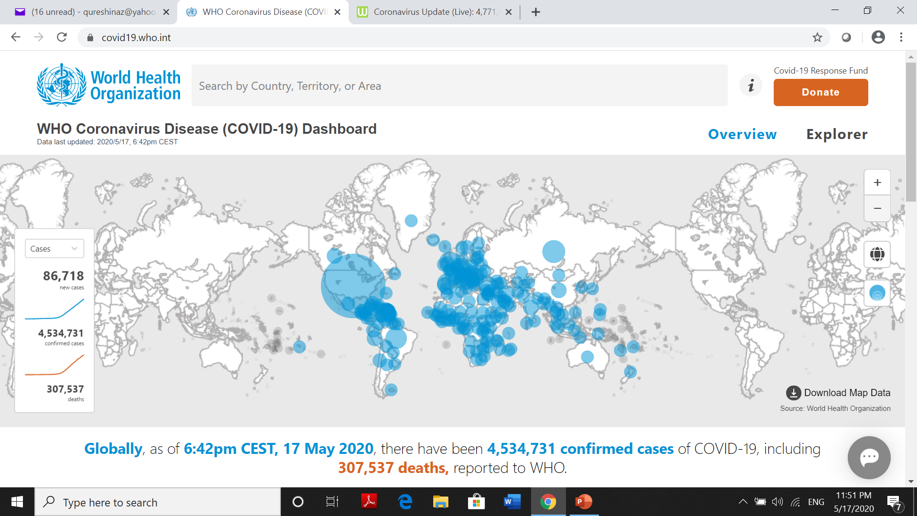


Slide 10
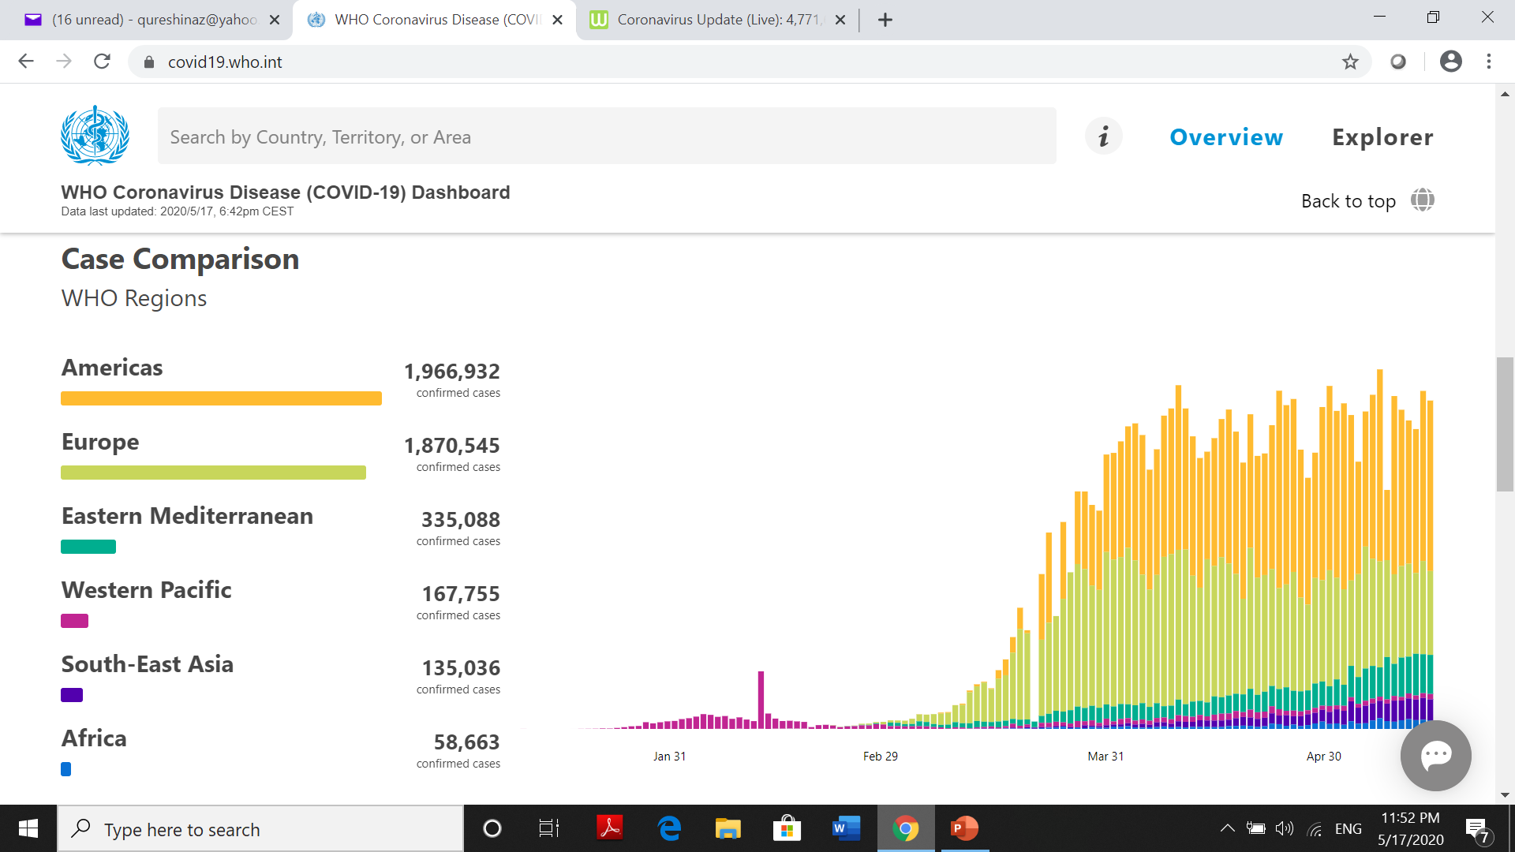

Slide 11
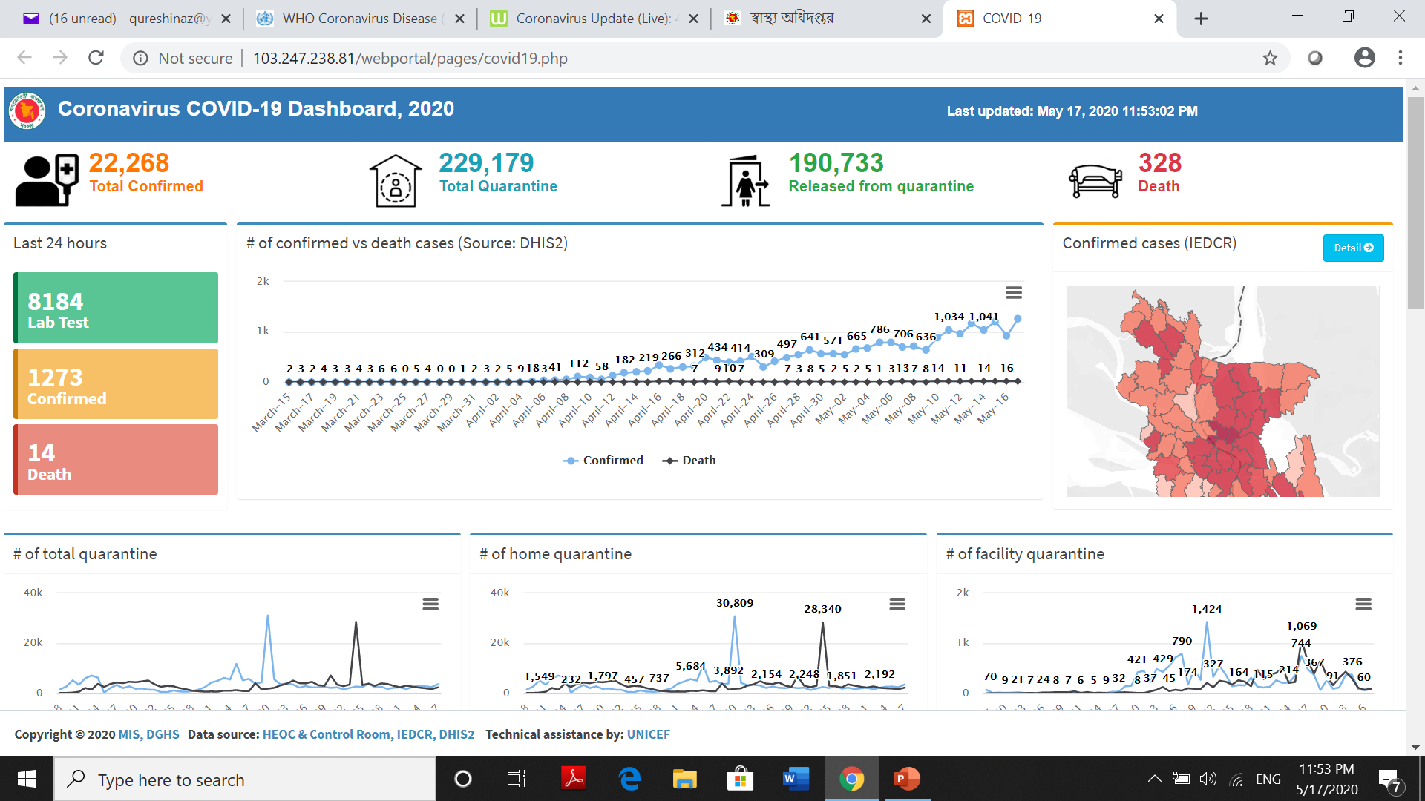

Slide 12
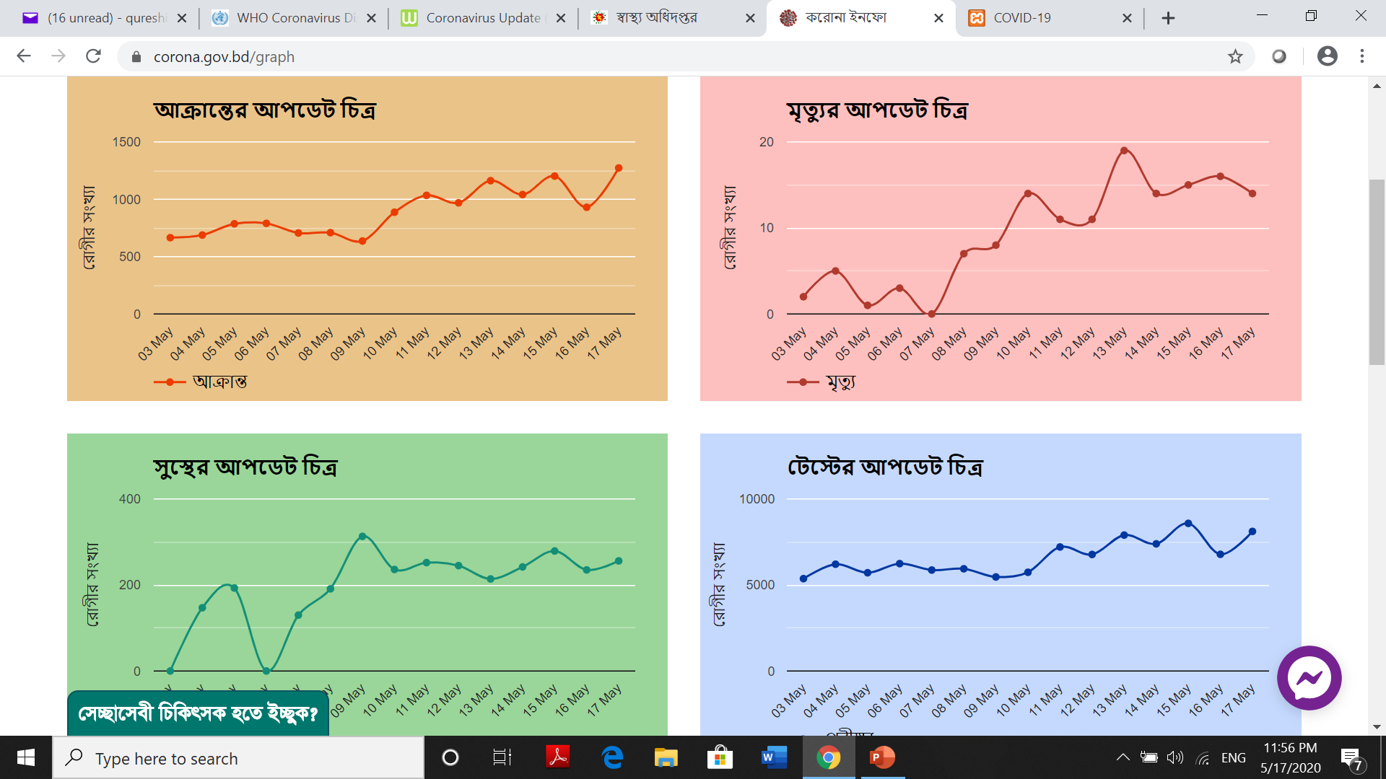

Slide 13
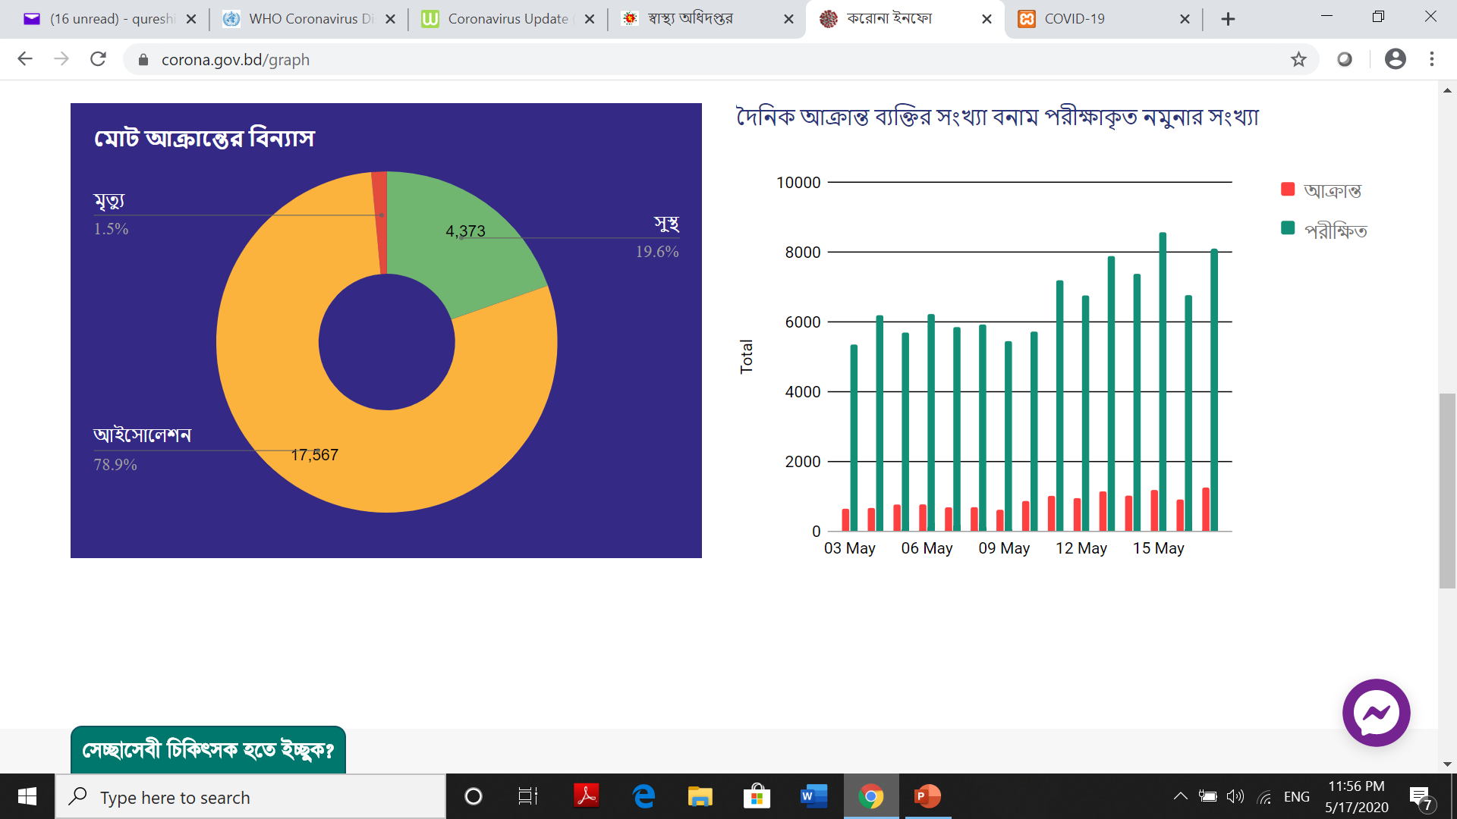

Slide 14
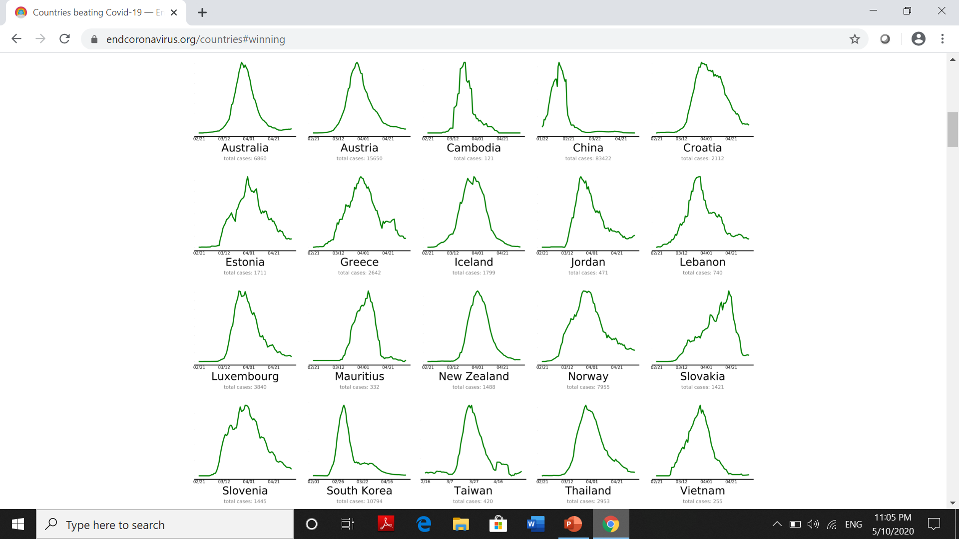

Slide 15
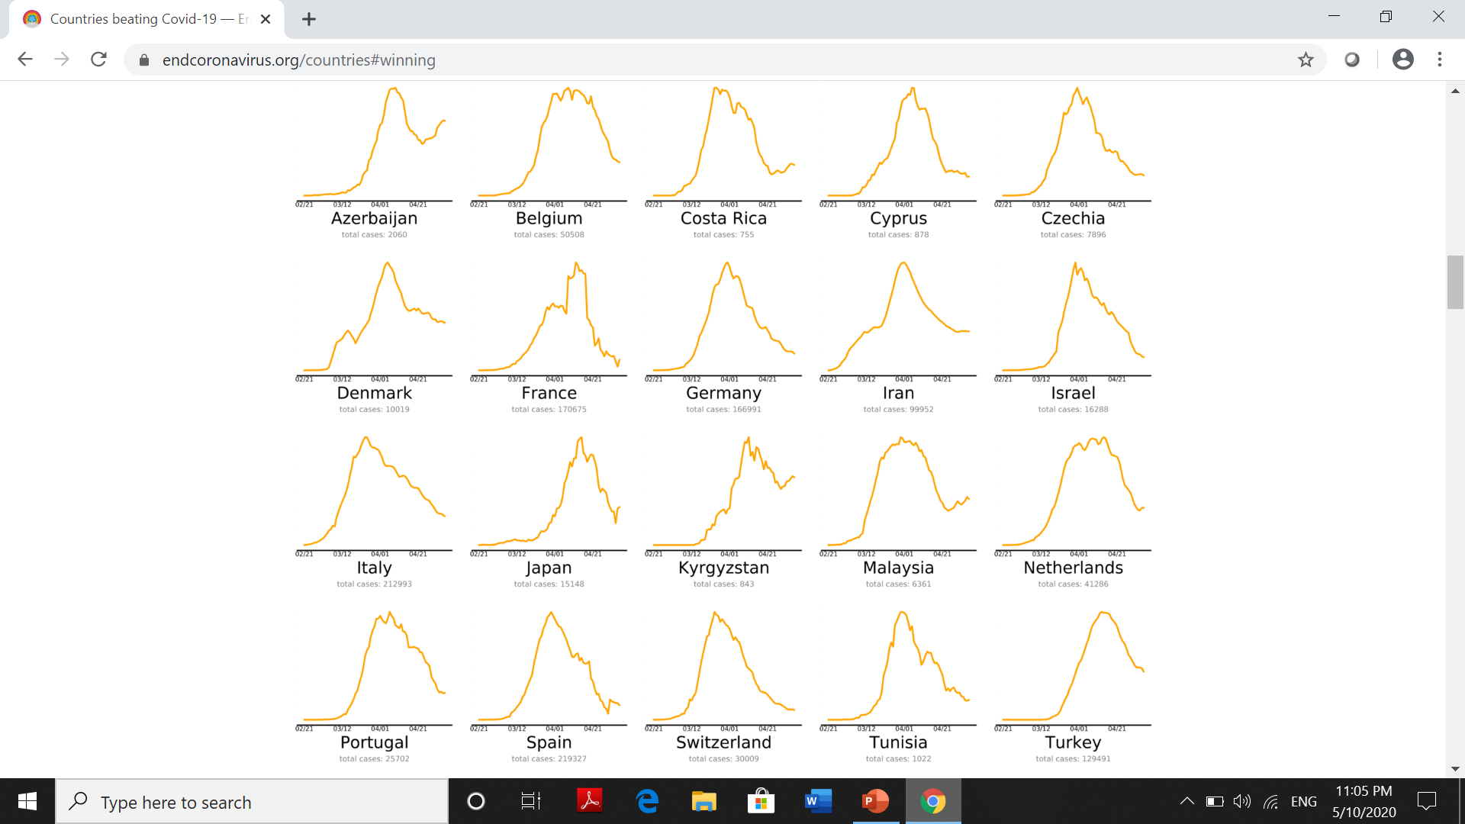

Slide 16
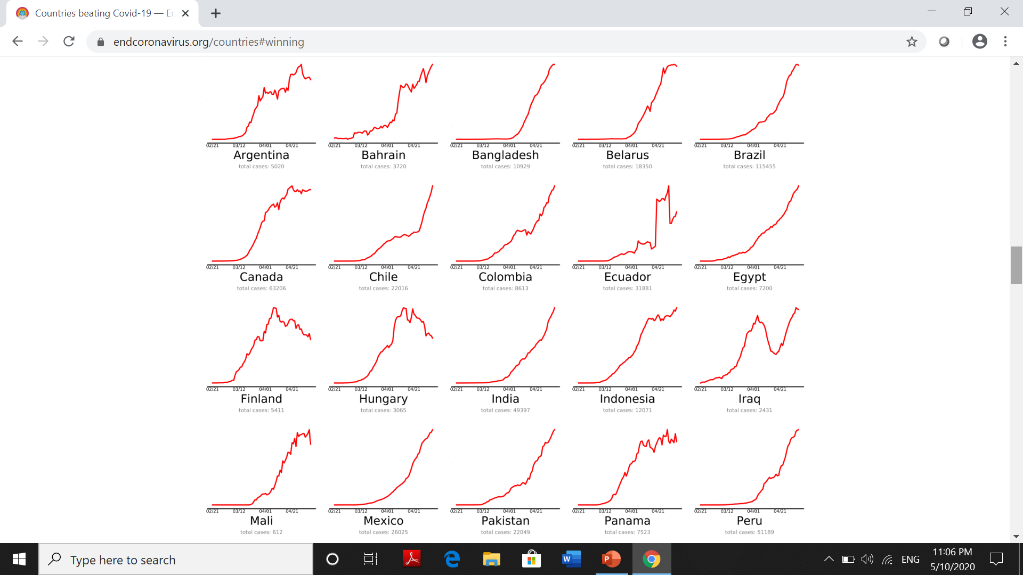

Slide 17
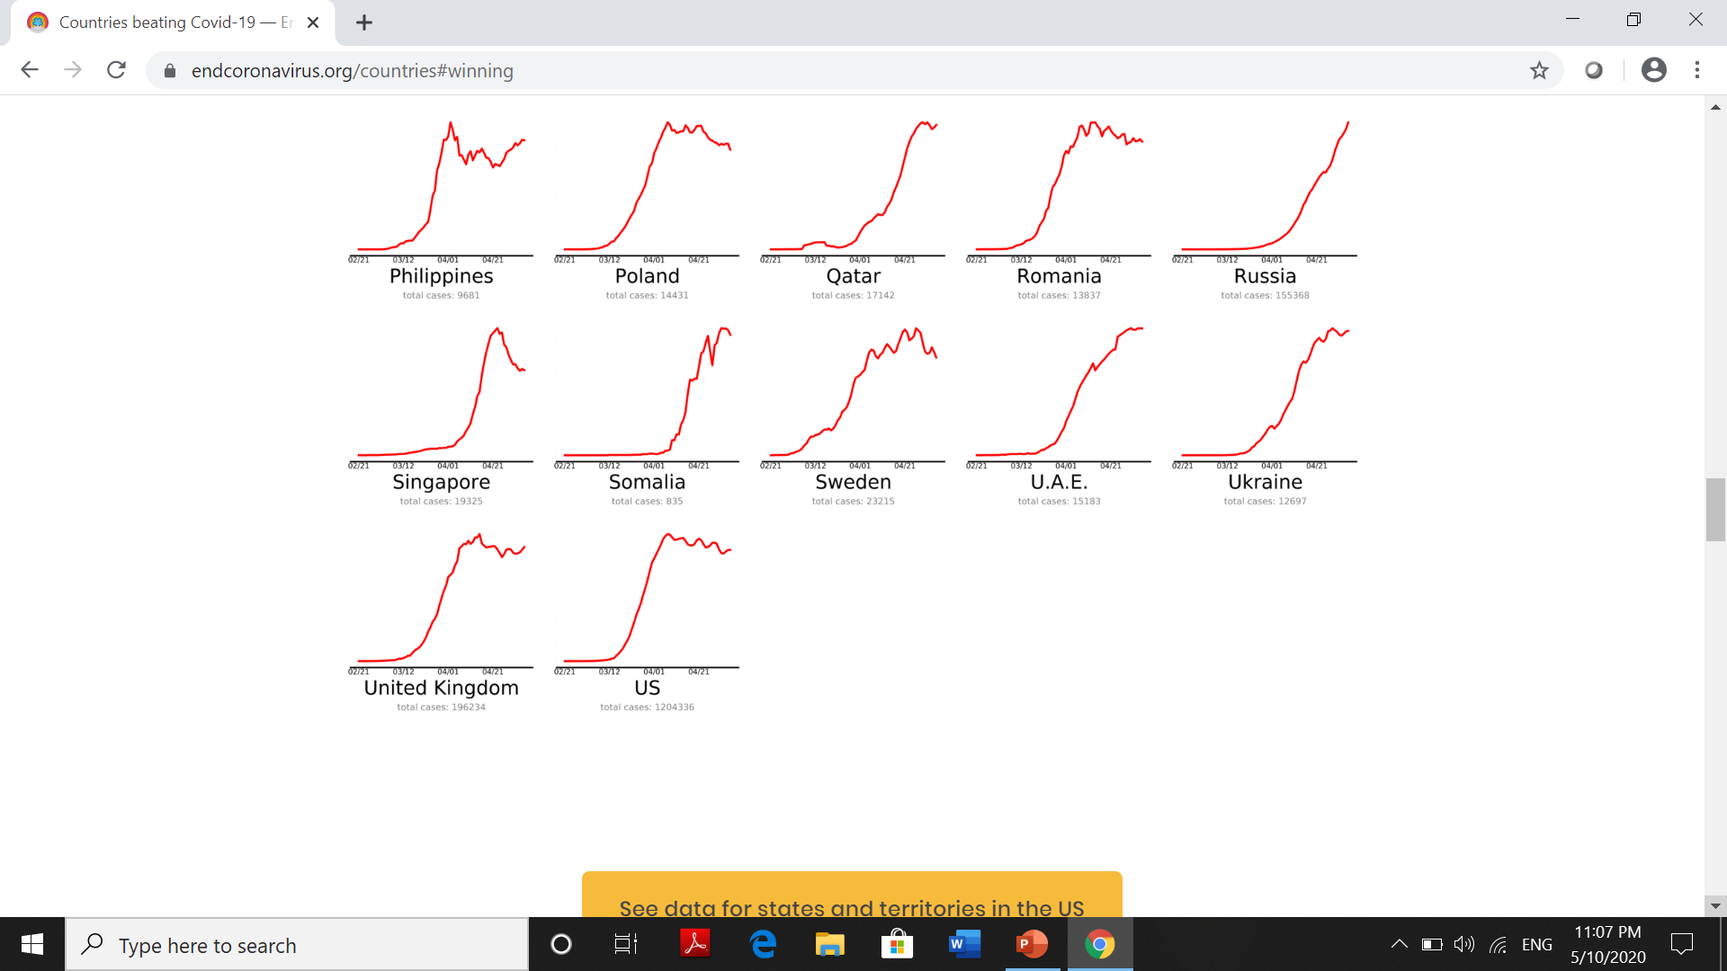

Slide 18
Clinical Presentation
Symptoms: 2-14 days after exposure:
Fever
Cough
Shortness of breath or difficulty breathing
Sore throat
Chills
Repeated shaking with chills
Muscle pain
Malaise
Headache
https://www.cdc.gov/coronavirus/2019-ncov/symptoms-testing/symptoms.html

Slide 19
Other less common symptoms
  nausea, vomiting, or diarrhea
Older adults and people who have severe underlying medical conditions like heart or lung disease or diabetes seem to be at higher risk for developing more serious complications from COVID-19 illness.
Children have similar symptoms to adults and generally have mild illness.
https://www.cdc.gov/coronavirus/2019-ncov/symptoms-testing/symptoms.html

Slide 20
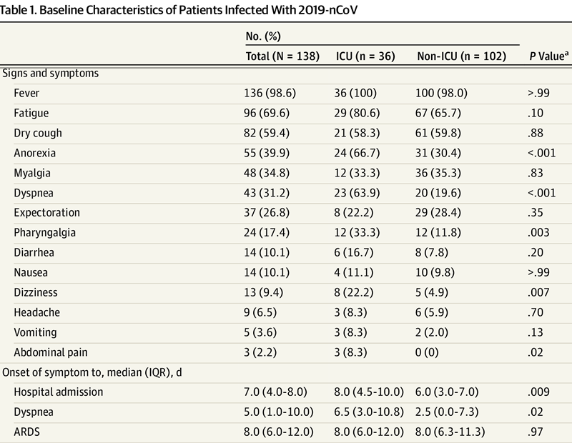
Clinical Characteristics of 138 Hospitalized Patients With 2019 Novel Coronavirus–Infected Pneumonia in Wuhan, China - JAMA, Wang et al., February 7, 2020

Slide 21
Newer presentations
Sudden stroke [https://edition.cnn.com/2020/04/22/health/strokes-coronavirus-young-adults/index.html]
Loss of smell and taste [https://www.sciencedaily.com/releases/2020/04/200413132809.htm]
Foot Lesions Reported As Symptom Of Covid-19 In Children, Some Adults [https://www.iflscience.com/health-and-medicine/foot-lesions-reported-as-symptom-of-covid19-in-children-some-adults/]

Slide 22
Widespread inflammation in the body. That, in turn, can lead to plaque in arteries> becoming unstable, affecting CVS:
  ACS,
  Vasculitis
  TE,
  myocarditis,
  heart failure.
  [https://www.scientificamerican.com/article/heart-damage-in-covid-19-patients-puzzles-doctors/]

Slide 23
Pediatric Multisystem Inflammatory Syndrome:
May 6, US state health department: officials said that 64 children have been hospitalized with the syndrome.
required “blood pressure support,” and some were on ventilators. Many of these patients also tested positive for COVID-19 or its antibodies.
[https://www.thecut.com/2020/05/is-kawasaki-disease-linked-to-coronavirus.html]

Slide 24
Tests
Molecular and Serological. FDA EUA
30 manufacturers to make molecular tests.
10 manufacturers to distribute serological test.
https://www.goodrx.com/blog/coronavirus-covid-19-testing-updates-methods-cost-availability/

Slide 25
Molecular Test: RT-PCR tests: few hours to a few days.
Rapid diagnostic tests that have been recently authorized:
Abbott: 5 minutes
Mesa Biotech: 30 minutes
Cepheid: 45 minutes
The new saliva-based test by Rutgers: result in 1 to 2 days
First at-home collection test by LabCorp: result in 1 to 2 days.
https://www.goodrx.com/blog/coronavirus-covid-19-testing-updates-methods-cost-availability/

Slide 26
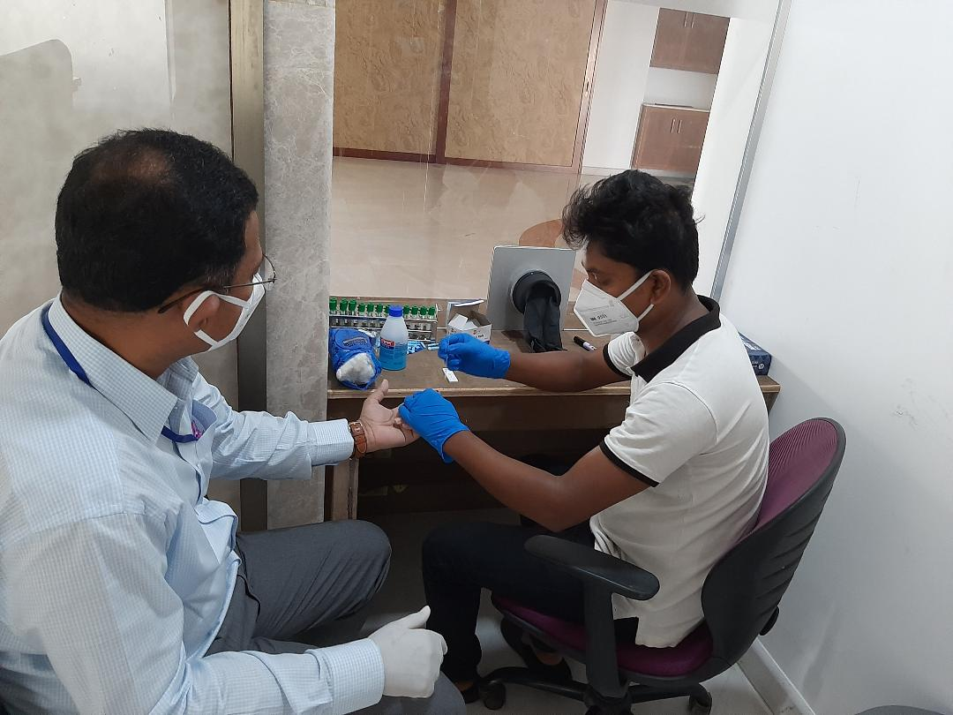
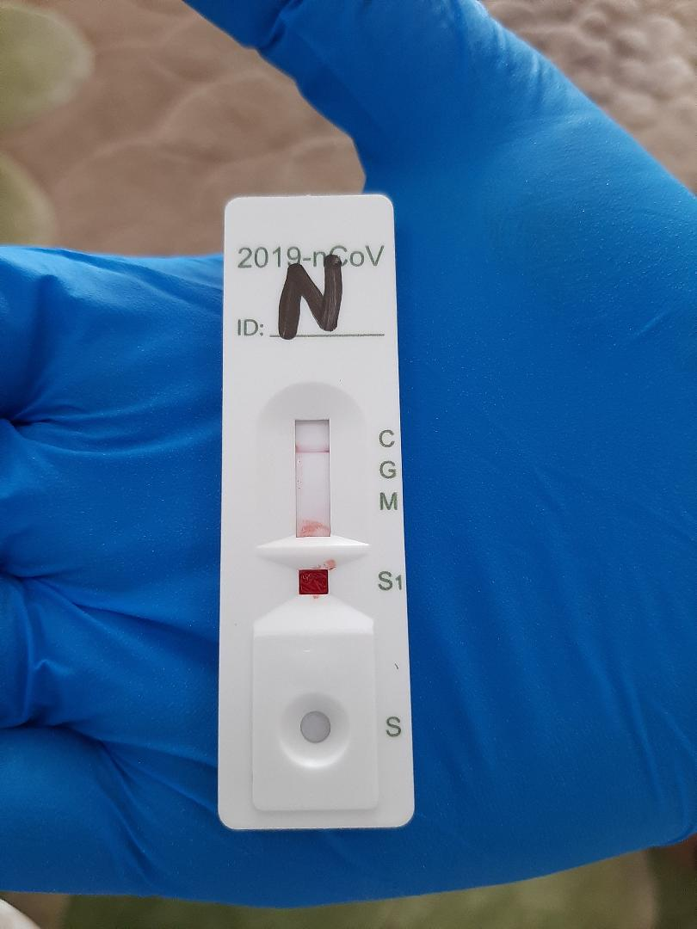
Serological tests:
faster than standard molecular tests.
Cellex: esults in about 15 minutes.
https://www.goodrx.com/blog/coronavirus-covid-19-testing-updates-methods-cost-availability/

Slide 27
Treatment options under study
Remdesivir (FDA EUA): interferes with the action of viral RNA-dependent RNA polymerase
Chloroquine and hydroxychloroquine (FDA EUA): Not clearly known, changes the pH of endosomes and believed to prevent viral entry, transport and post-entry events
Convalescent Plasma (FDA emergency Investigational New Drug Applications )
Hyperimmune Globulin (FDA emergency Investigational New Drug Applications )
Favipiravir: interferes with the action of viral RNA-dependent RNA polymerase
Lopinavir/Ritonavir: Protease inhibitor
Interferon beta-1a: Stimulate innate antiviral immunity.
Ivermectin/Doxycycline
………………………………..
www.who.int/emergencies/diseases/novel-coronavirus-2019/global-research-on-novel-coronavirus-2019-ncov/solidarity-clinical-trial-for-covid-19-treatments

Slide 28
Vaccine
Phase I-II trials
Ad5-nCoV | Phase II | China | > 102 Candidate vaccines globally
INO-4800 | Phase I | US, Korea
ChAdOx1 nCoV-19 | Phase I > II | UK
BNT162 (a1, b1, b2, c2) | Phase I > II | Germany US
LV-SMENP-DC and a pathogen-specific aAPC | Phase I | China
https://www.gavi.org/vaccineswork/covid-19-vaccine-race

Slide 29
Covid-19 & DM
Patients with diabetes may be at extra risk for coronavirus disease (COVID-19) and mortality.
Most health advisories (WHO, IDF, ADA & CDC) mentioned that people with diabetes are among those high-risk categories that can have serious illness.
IDF: COVID-19 outbreak: guidance for people with diabetes; ADA: COVID-19 , Diabetes Res Clin Pract. March 2020 (https://doi.org/10.1016/j.diabres.2020.108118)

Slide 30
COVID-19 with diabetes
  progress rapidly to ARDS
  septic shock
  multiple organ failure
Diabetes Res Clin Pract. March 2020 (https://doi.org/10.1016/j.diabres.2020.108118)

Slide 31
Chinese Centre for Disease Control and Prevention report summarizing data from 72,314 cases:
Overall CFR: 2.3%.
CFR for diabetes: 7.3%
https://jamanetwork.com/journals/jama/article-abstract/2762130
https://www.cebm.net/covid-19/diabetes-and-risks-from-covid-19/

Slide 32
Retrospective review of 1,590 laboratory-confirmed hospitalized patients in China across 575 hospitals composite endpoints: admission to ICU, intensive ventilation, or death, and found that after adjusting for age and smoking status,
Diabetes significantly increased risk (hazard ratio 1.59, 95% CI 1.03–2.45).
34.6% of severe cases were in PWDiabetes.
https://erj.ersjournals.com/content/early/2020/03/17/13993003.00547-2020
https://www.cebm.net/covid-19/diabetes-and-risks-from-covid-19/

Slide 33
Hypertension and diabetes:
Coronavirus binds to target cells through angiotensin-converting enzyme 2 (ACE2), which expressed in the epithelial cells in the lungs, blood vessels and in the intestine. In patients treated with ACE and angiotensin II receptor blockers, expression of ACE2 is increased. Therefore, it has been suggested that ACE2 expression may be increased in these two groups of patients with hypertension and diabetes, which could facilitate infection with COVID-19 and increase the risk of severe disease and fatality.
Wan Y, Shang J, Graham R, et al. Receptor recognition by the novel coronavirus from Wuhan: An analysis based on decade-long structural studies of SARS coronavirus. J Virol. 2020;94. pii: e00127-20.
Hoffmann M, Kleine-Weber H, Schroeder S, et al. SARS-CoV-2 cell entry depends on ACE2 and TMPRSS2 and is blocked by a clinically proven protease inhibitor. Cell. 2020; pii: S0092-8674(20)30229-4. doi: 10.1016/j.cell.2020.02.052.
Li XC, Zhang J, Zhuo JL. The vasoprotective axes of the renin-angiotensin system: Physiological relevance and therapeutic implications in cardiovascular, hypertensive and kidney diseases. Pharmacol Res. 2017;125:21–38.

Slide 34
Diabetes patients have impaired immune-response to infection both in relation to cytokine profile and to changes in immune-responses including T-cell and macrophage activation.¹⁵
Poor glycaemic control impairs several aspects of the immune response to viral infection and also to the potential bacterial secondary infection in the lungs.¹⁶
It is likely that many of the patients with diabetes in China have been in poor metabolic control when infected by COVID-19.
Many patients with type 2 diabetes are obese and obesity is also a risk factor for severe infection.^{17–9} It was illustrated during the influenza A H1N1 epidemic in 2009 that the disease was more severe and had a longer duration in about twofold more patients with obesity who were then treated in intensive care units compared with background population.^{14,17,18} Specically, metabolic active abdominal obesity is associated with higher risk.¹⁷⁻⁹ The abnormal secretion of adipokines and cytokines like TNF-alfa and interferon characterise a chronic low-grade in abdominal obesity and may induce an impaired immune-response.. ^{17–9} People with severe abdominal obesity also have mechanical respiratory problems, with reduced ventilation of the basal lung sections increasing the risk of pneumonia as well as reduced oxygen saturation of blood.²⁰ Obese subjects also have an increased asthma risk, and those patients with obesity and asthma have more symptoms, more frequent and severe exacerbations and reduced response to several asthma medications. ²⁰

Slide 35
Ferlita S, Yegiazaryan A, Noori N et al. Type 2 diabetes mellitus and altered immune system leading to susceptibility to pathogens, especially mycobacterium tuberculosis. J Clin Med. 2019;8. pii: E2219.
Critchley JA, Carey IM, Harris T et al. Glycemic control and risk of infections among people with type 1 or type 2 diabetes in a large primary care cohort study. Diabetes Care. 2018;41:2127–35.
Huttunen R, Syrjänen J. Obesity and the risk and outcome of infection. Int J Obes (Lond). 2013;37:333–40.
Honce R, Schultz-Cherry S. Impact of obesity on influenza a virus pathogenesis, immune response, and evolution. Front Immunol. 2019;10:1071.
Almond MH, Edwards MR, Barclay WS, Johnston SL. Obesity and susceptibility to severe outcomes following respiratory viral infection. Thorax. 2013;68:684–6.
Dixon AE, Peters U. The effect of obesity on lung function. Expert Rev Respir Med. 2018;12:755–67.

Slide 36
End of Presentation
Thank You
&
Stay Safe

